Slide 1



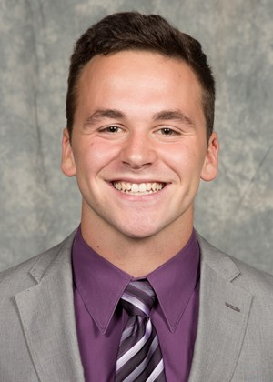

Andy Souders
President & CEO
James Cole
Territory Manager
Corey Hart
Account Manager
Welcome to the Webinar
PUTTING THE BRAKES ON SPEEDING: NOW AND AFTER THE PANDEMIC
Notes:
Good afternoon! I’m James Cole, Territory Manager for All Traffic Solutions. I’d like to thank you all for joining us today for a very timely topic: how to reduce dangerous speeding now during the coronavirus outbreak and continue to slow down drivers as things return to normal.

Slide 2
WHAT WE’LL COVER TODAY
Reasons behind the dangerous high-speed trend
Share eye-opening customer data from ATS TraffiCloud® showing areas with zero increase despite the trend
How you can use portable radar signs and radar message displays to collect report-ready data remotely
Demonstrate easy setup of speed-dependent messaging using TraffiCloud
Q & A: Submit questions using the Chat box on your control panel at any time during the presentation
Notes:
Here’s what we’ll talk about today. First, we’ll look at the current trends we’re seeing during the shutdown…
Then, Andy Souders, our CEO, will share data gathered from our TraffiCloud software about what we’re seeing across the country
Corey will demonstrate how to set up speed-dependent messaging for our SpeedAlert radar message displays in TraffiCloud, and I’ll tell you about ATS portable radar signs.
Then we’ll take some time to answer your questions, which you can submit using the Chat box on your control panel.

Slide 3

WE MAKE COMMUNITIES SAFER
PLACES TO LIVE AND WORK
Headquartered in Herndon, VA with signs manufactured in State College, PA
Maximize resources and budget and save lives
Provide simple solutions for speed enforcement, information sharing and intelligent transportation
Patented TraffiCloud software: real-time data and analytics
Remote management from any Internet-connected device
All ATS products are made in the USA
with US-based service and support
Notes:
First, a quick overview of who were are.

Slide 4



TRUSTED BY 5,000+
Customers in All 50 States and 20 Countries Since 1999
Law Enforcement
Public Works
Federal & Municipal
Transportation Departments
Emergency Management
Traffic Engineering
Large Public Venues
Education
Facility Safety & Security
Corporate Campuses

Slide 5
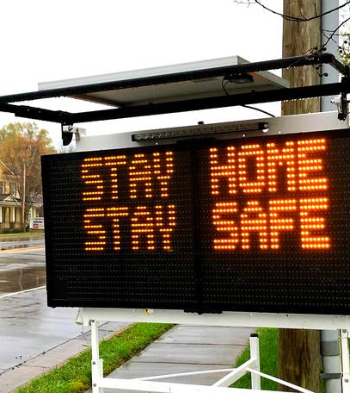
THE SITUATION
Traffic volumes are way down as more Americans are working from home or unemployed
Many are frustrated, bored and stressed
Rush hour and road volumes are down as much as 65% or more
High school and college is out – more new drivers on the road
Road work has increased – adding another hazard
No school – more pedestrians and kids on bikes

Slide 6
NEW REALITY ON THE ROADS
Average speeds are 30–40% higher with over 80% exceeding the speed limit
Crashes are more severe – traffic deaths more than doubled in some states
State troopers pulling people over doing 120+ mph
At risk: Travelers, pedestrians, law enforcement and first responders
Speed cameras issuing the same number of tickets despite 50% less cars on the road

Slide 7
FATALITY RATES GROW EXPONENTIALLY
The risk of injury and death increases as speed increases
Source: US Department of Transportation
Notes:
Here’s a sobering fact…
Now I’d like to introduce Andy Souders, who will share some very interesting TraffiCloud data.

Slide 8
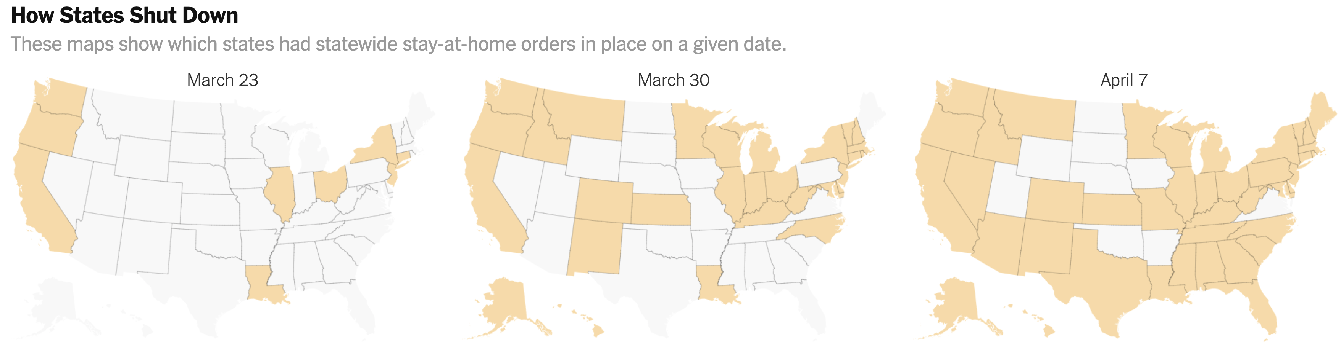
COVID-19 SHUTDOWNS BY STATE
Source: New York Times

Slide 9
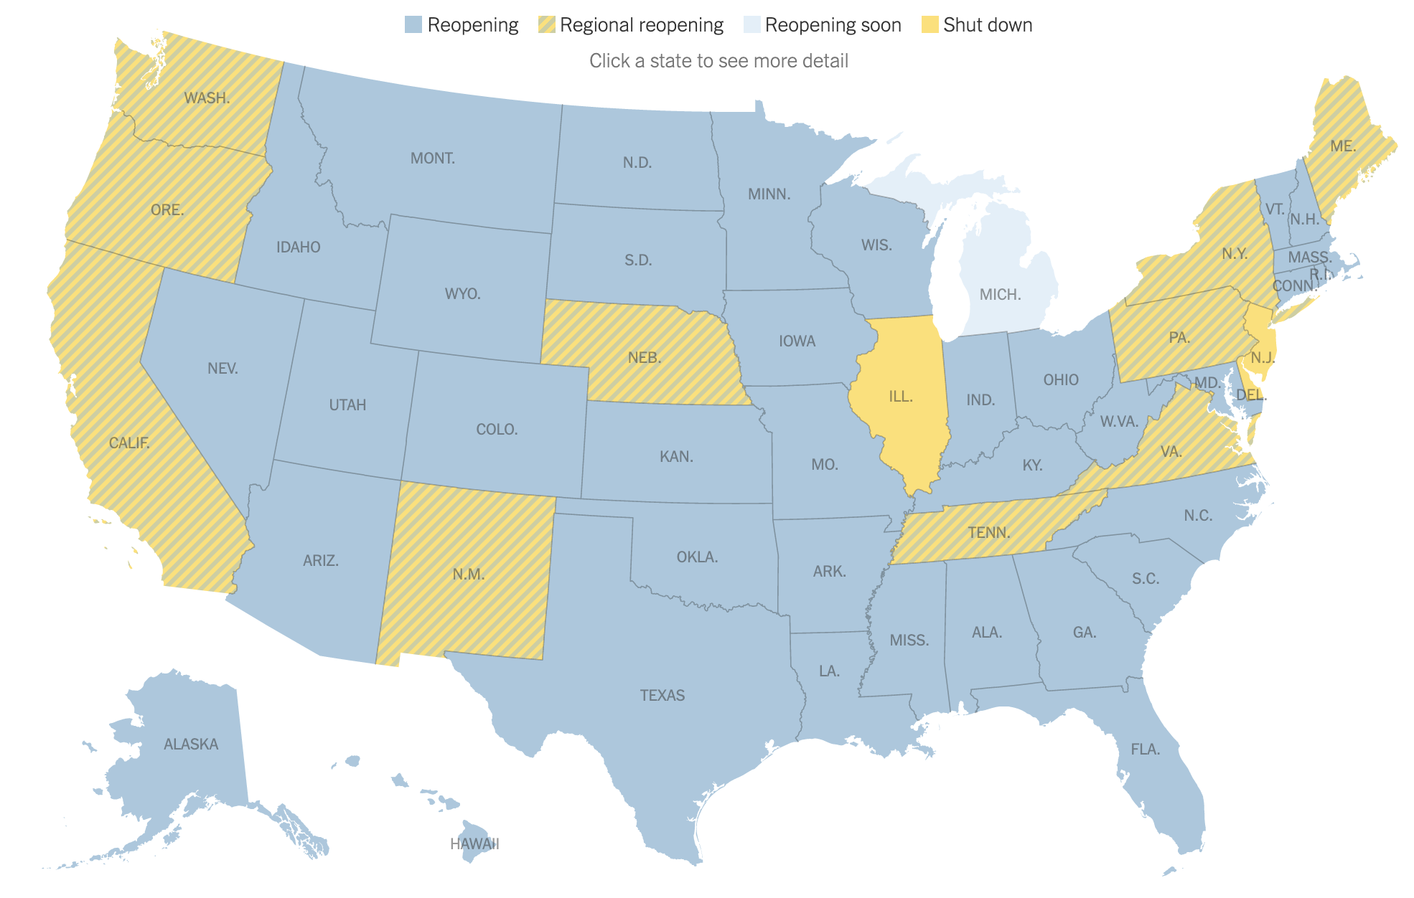
COVID-19 SHUTDOWNS BY STATE
Source: New York Times

Slide 10
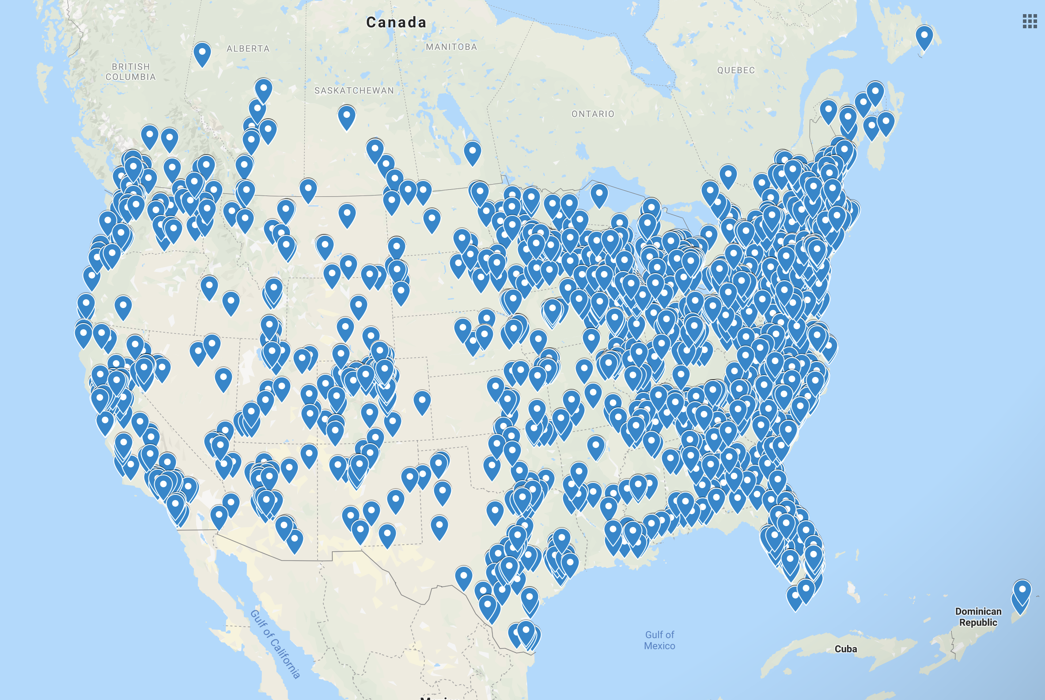
ATS FOOTPRINT

Slide 11

TRAFFIC STUDY LOCATIONS
Source: New York Times

Slide 12
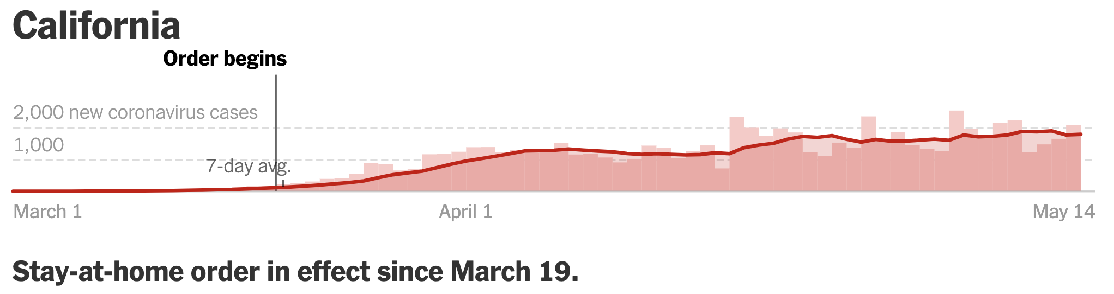

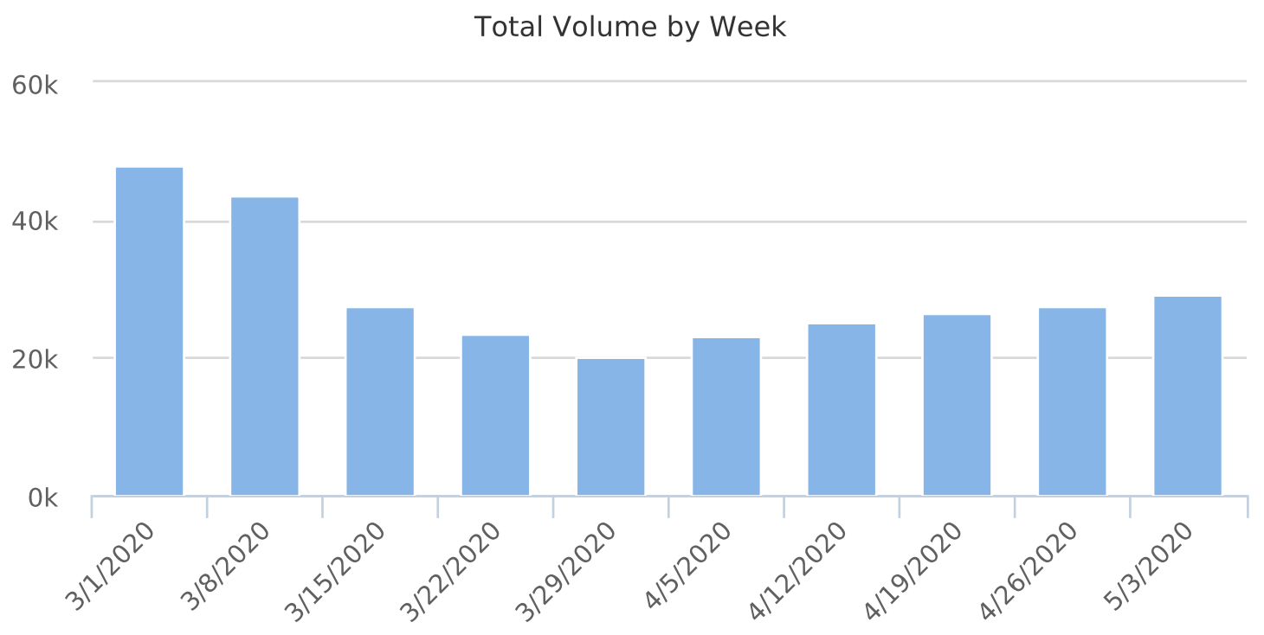
LOCATION 1: SAN FRANCISCO BAY AREA
Source: New York Times
Traffic Volumes
Week of March 15: Decline in response to stay-at-home order
Week of March 29: 41.7% of pre-pandemic volume (lowest point)
50% increase in volume since March 29

Slide 13
LOCATION 1: SAN FRANCISCO BAY AREA
Average speed within 3 mph of pre-COVID average
Slowest average speed was during the week with the LOWEST volume

Slide 14
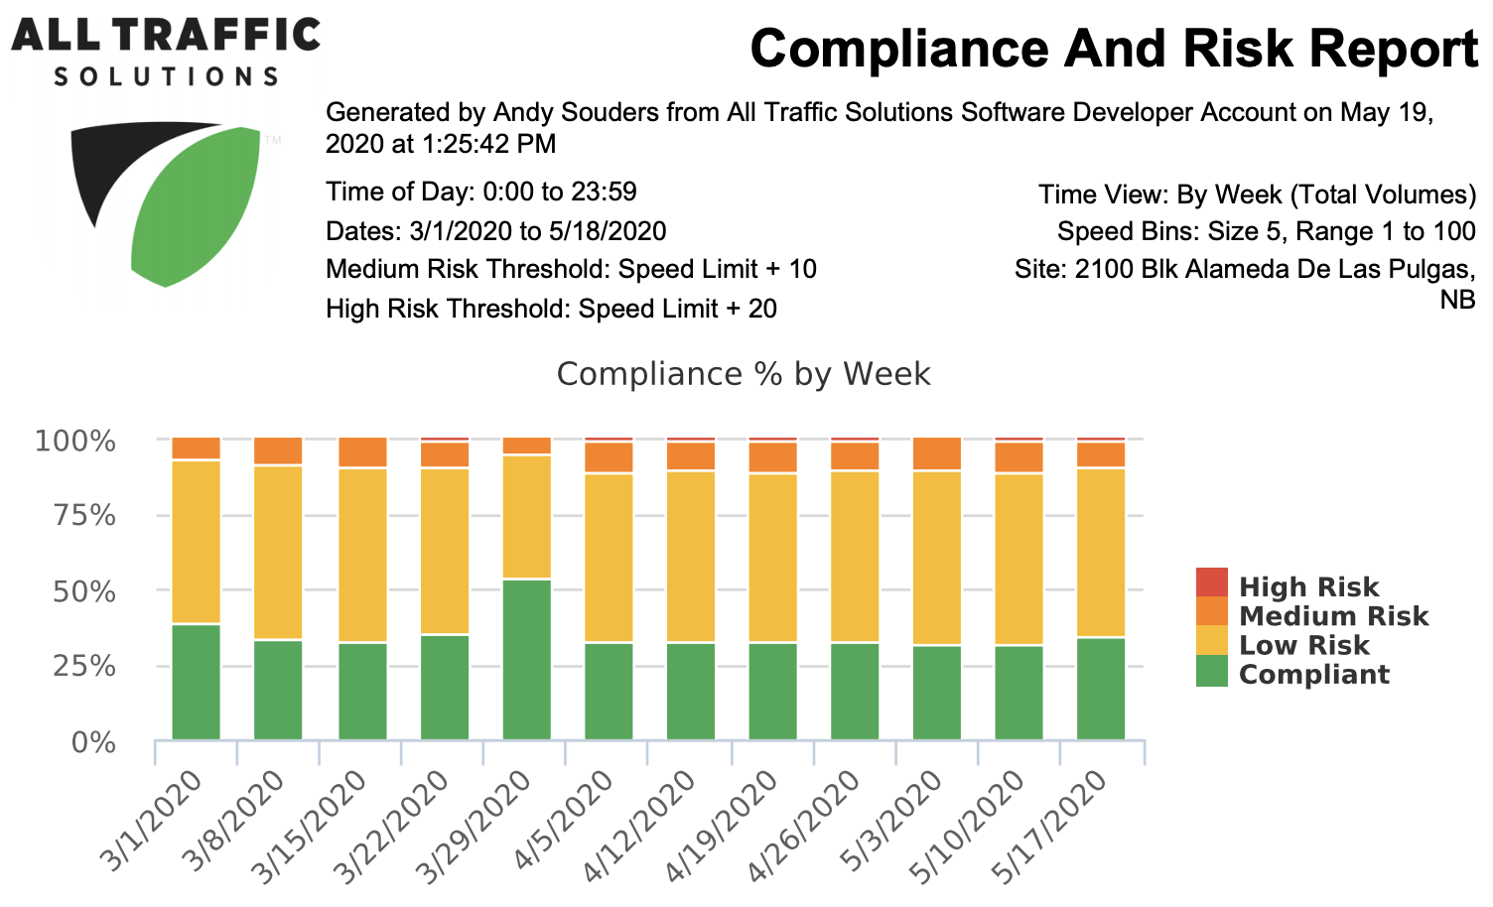
LOCATION 1: SAN FRANCISCO BAY AREA

Slide 15
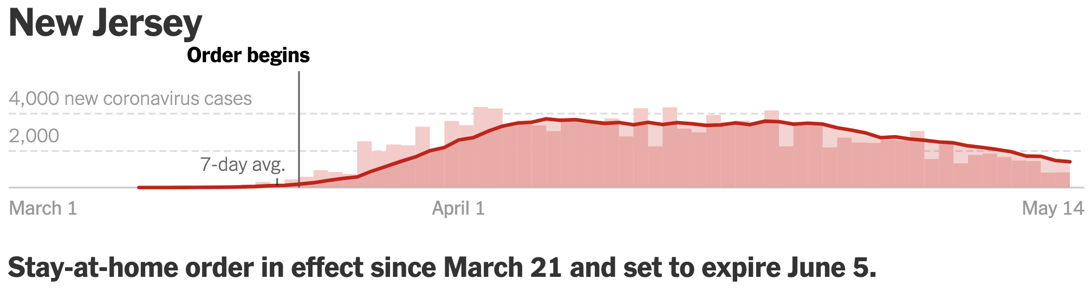
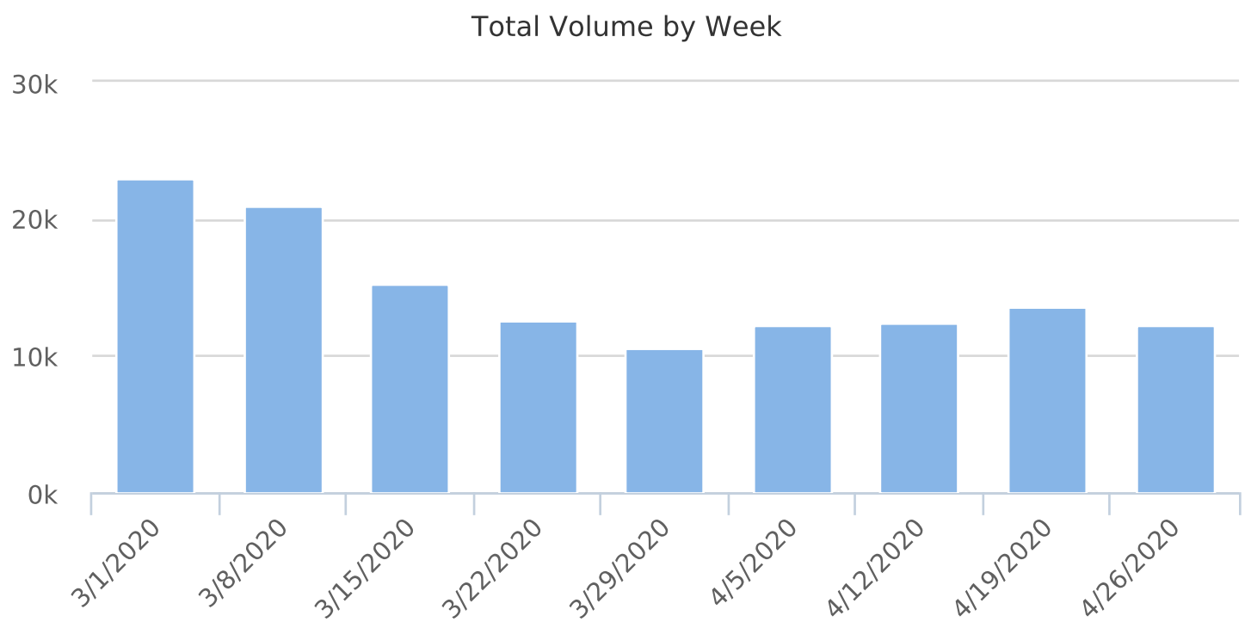
LOCATION 2: NEW JERSEY –– 20 MILES FROM NYC
Source: New York Times
Traffic Volumes
Week of March 15: Decline in response to stay-at-home order
Week of March 29: 45.8% of pre-pandemic volume (lowest point)
25% increase in volume since March 29

Slide 16
LOCATION 2: NEW JERSEY –– 20 MILES FROM NYC

Slide 17
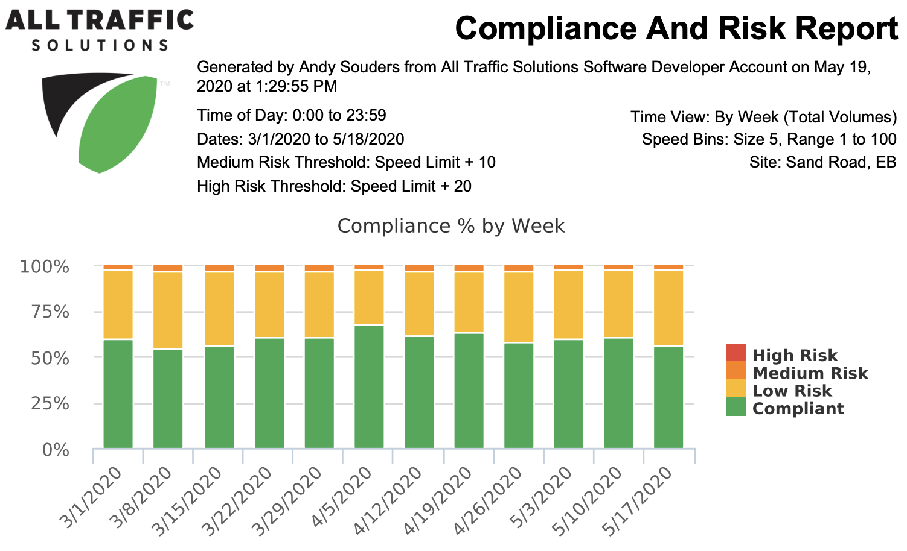
LOCATION 2: NEW JERSEY – 20 MILES FROM NYC

Slide 18
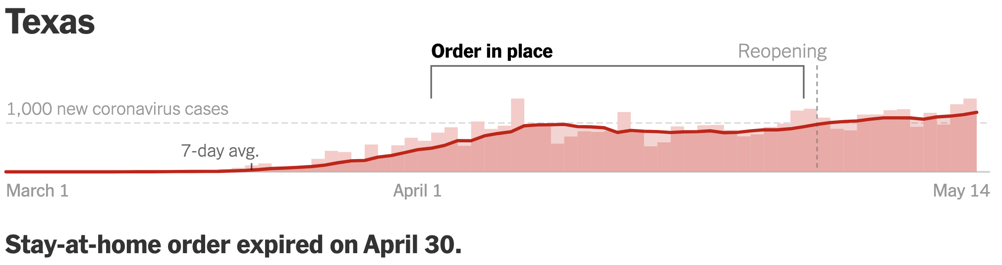
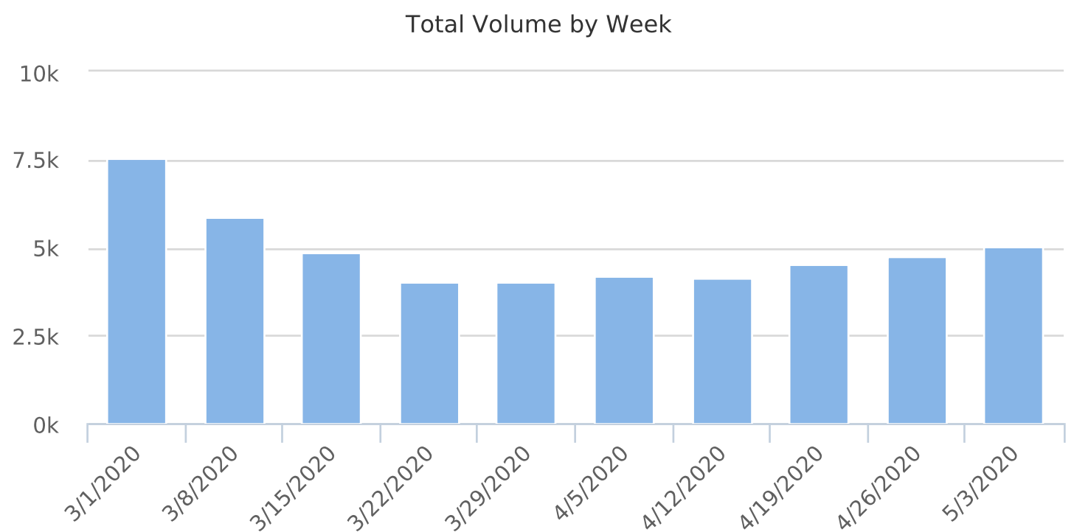
LOCATION 3: DALLAS TEXAS AREA
Source: New York Times
Traffic Volumes
Week of March 8: Start to see decline, 20%+ drop
Week of March 29: 53% of pre-pandemic volume (lowest point)
20% increase in volume since March 29

Slide 19
LOCATION 3: DALLAS TEXAS AREA

Slide 20
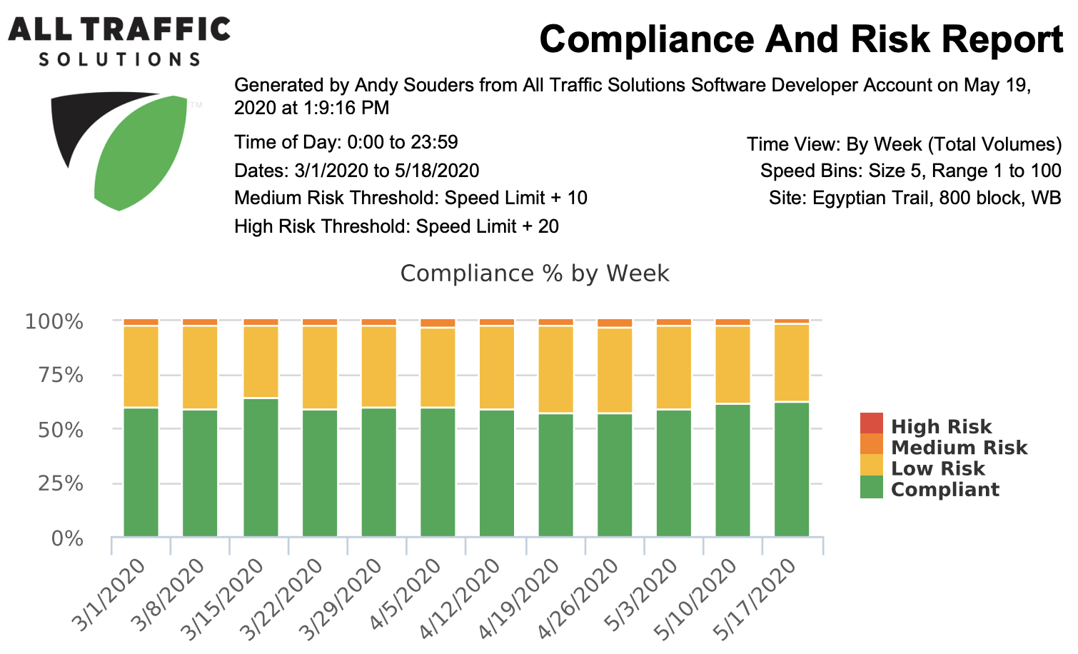
LOCATION 3: DALLAS TEXAS AREA

Slide 21
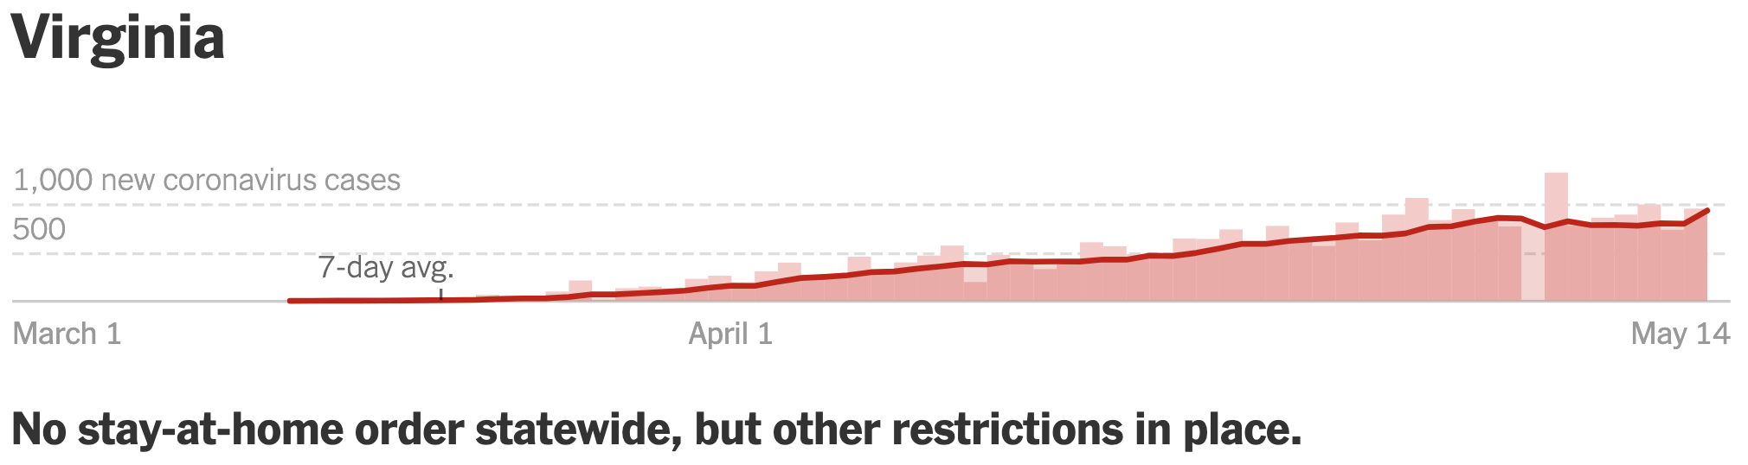
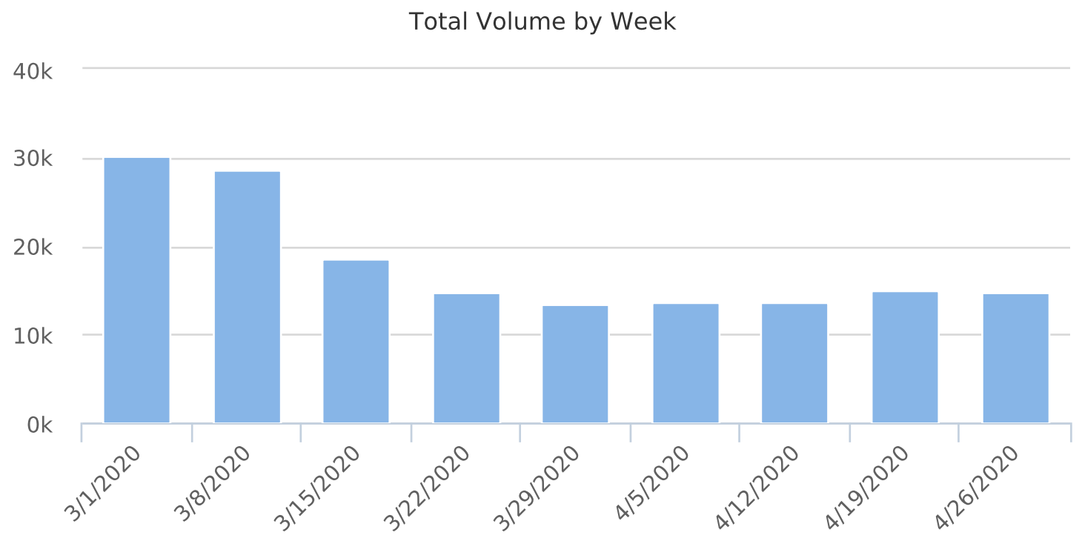
LOCATION 4: NORTHERN VIRGINIA
Source: New York Times
Traffic Volumes
Week of March 15: Start to see decline, 34%+ drop
Week of March 29: 44.6% of pre-pandemic volume (lowest point)
4.2% increase in volume since March 29

Slide 22
LOCATION 4: NORTHERN VIRGINIA

Slide 23
LOCATION 4: NORTHERN VIRGINIA

Slide 24
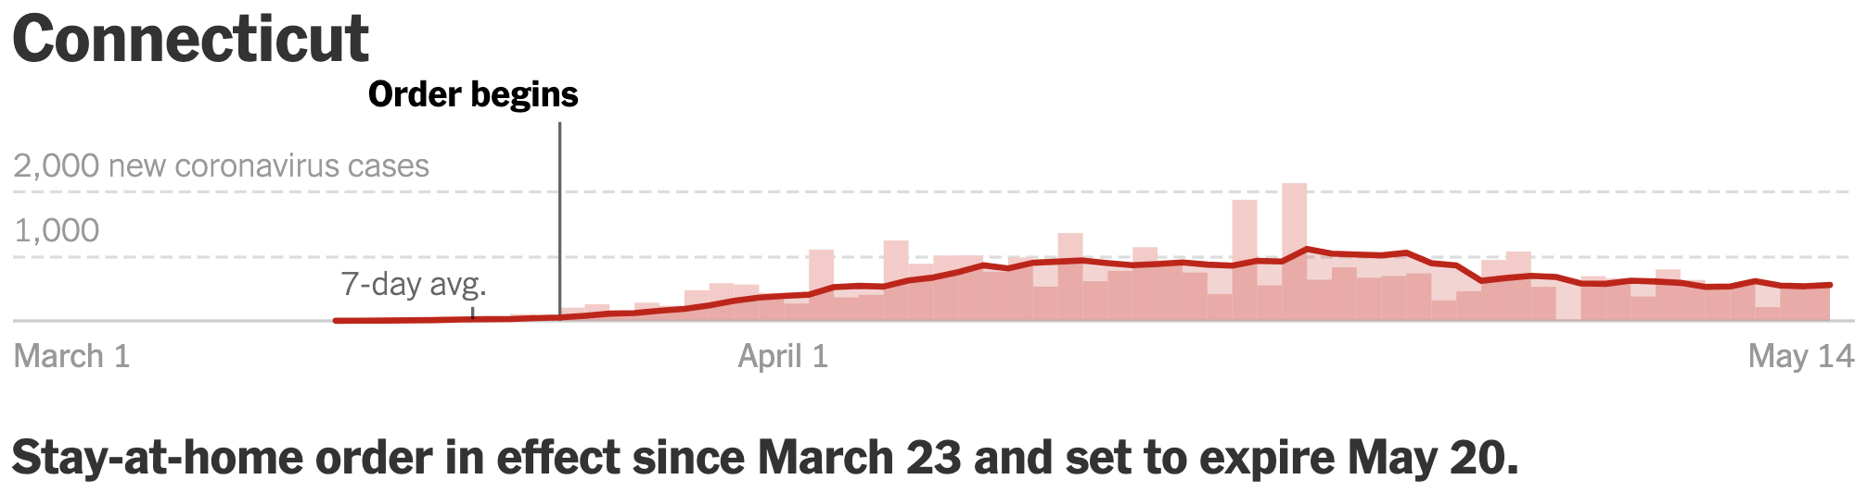
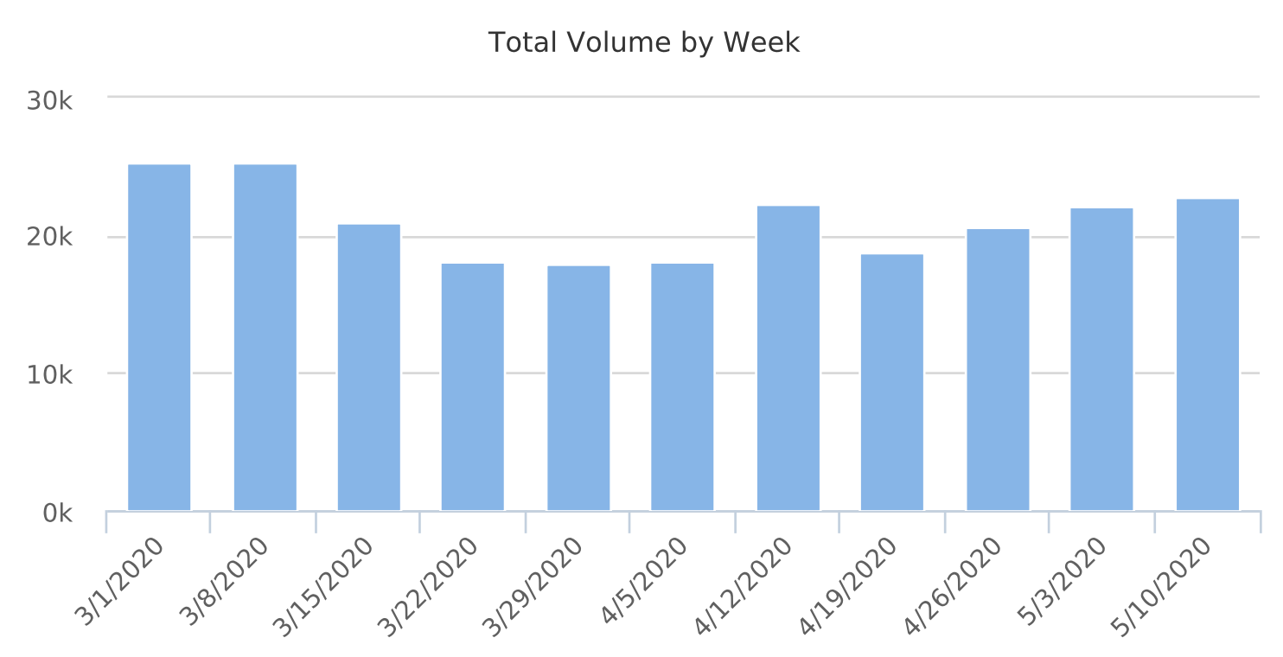
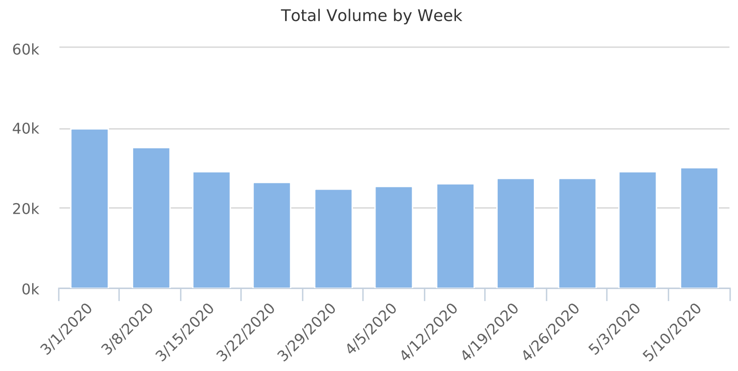
LOCATION 5: CONNECTICUT
A Tale of Two Sites
Source: New York Times
Site 1
Site 2

Slide 25
LOCATION 5: CONNECTICUT
Site 1
Site 2

Slide 26
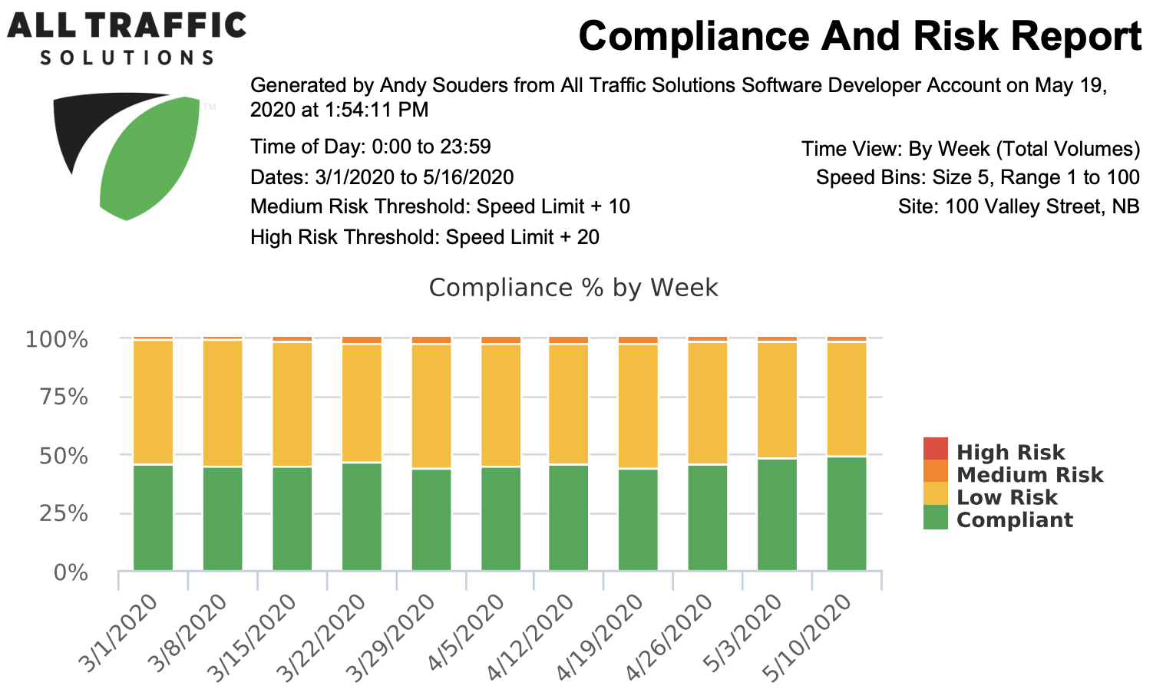
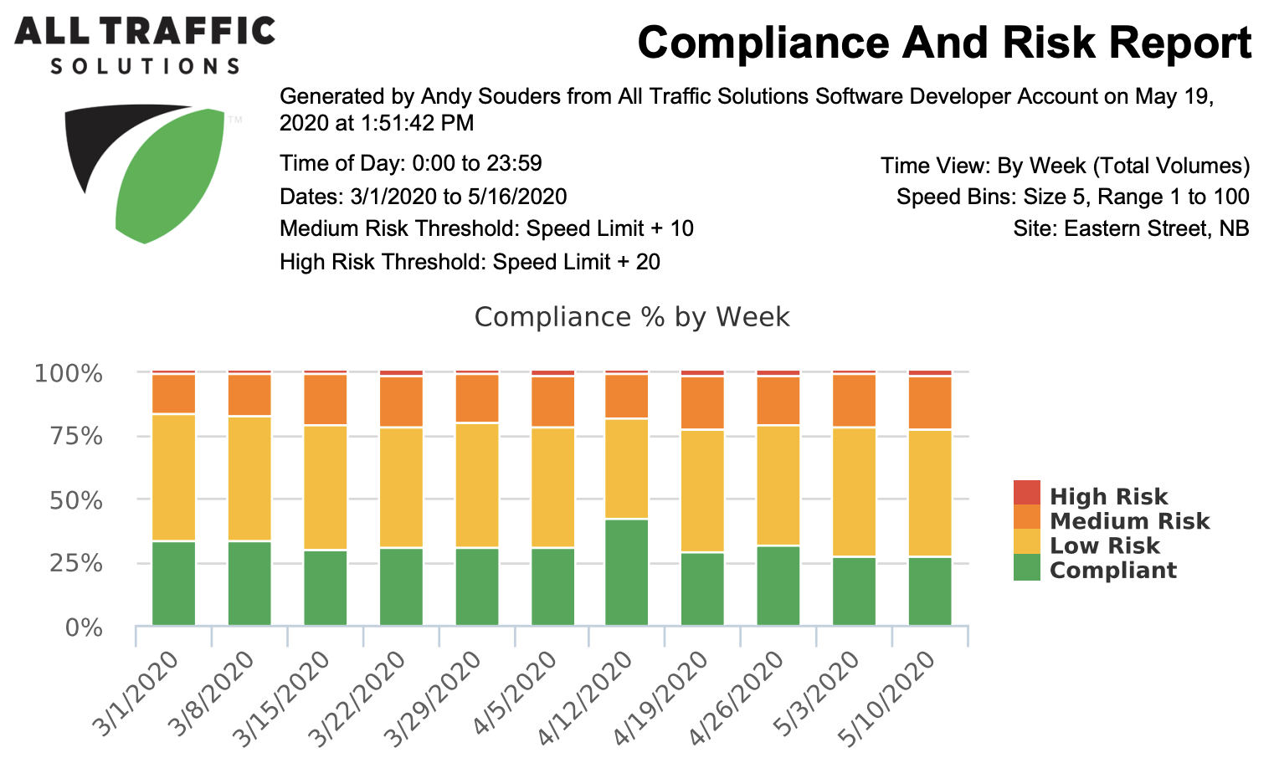
LOCATION 5: CONNECTICUT

Slide 27
LOCATION 5: CONNECTICUT
Biggest difference in percentage of violators

Slide 28

LOCATION 5: CONNECTICUT
Site 1
Site 2

Slide 29
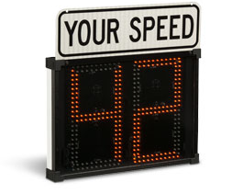
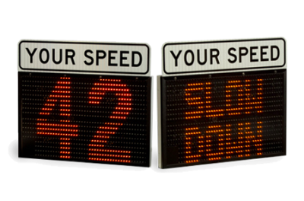
LOCATION 5: CONNECTICUT
Site 1
Site 2
SHIELD 15 IN USE
Displays speeds up to 45 mph
Strobes at 30 mph
SPEEDALERT 18 IN USE
Displays speeds up to 85 mph
Strobes at 20 mph
Dependent messaging

Slide 30
REMOTE PROGRAMMING
WITH TRAFFICLOUD
Notes:
Thank Andy! I’m going to demonstrate how easy it is to remotely program your SpeedAlert 24 radar message sign using TraffiCloud software.

Slide 31
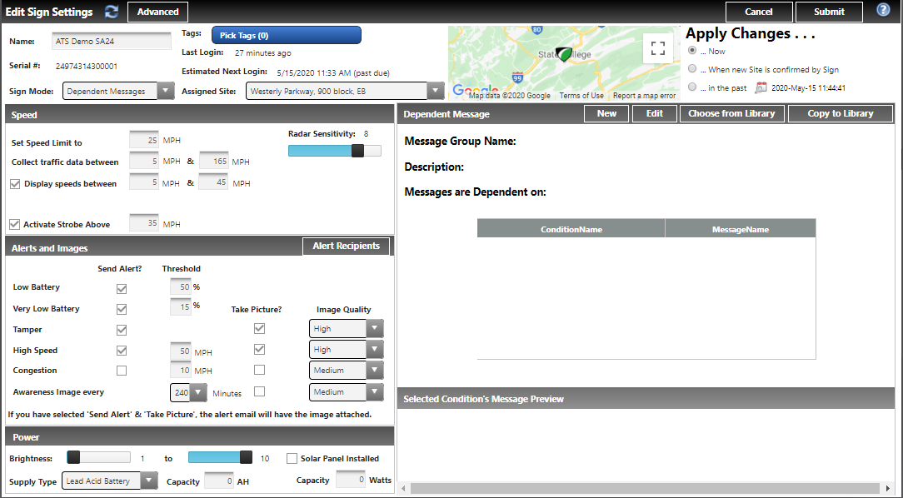
SPEED-DEPENDENT MESSAGING

Slide 32
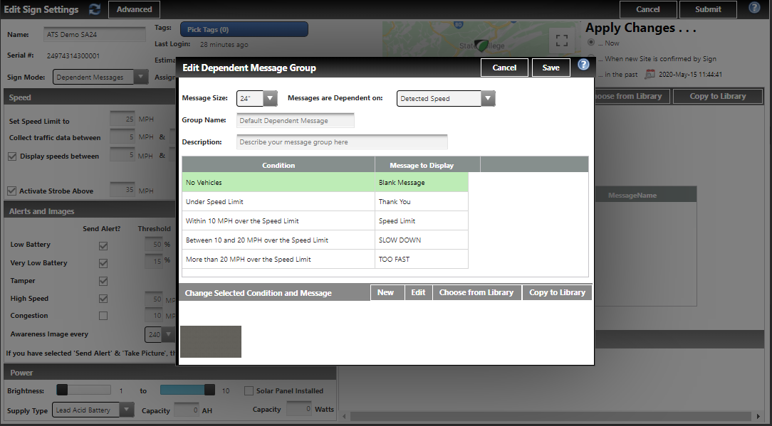
SPEED-DEPENDENT MESSAGING

Slide 33
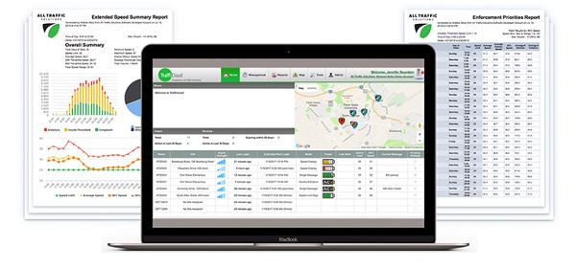
REQUEST A TRAFFICLOUD DEMO
AllTrafficSolutions.com/contact
Notes:
If you would like to request a demo of TraffiCloud you can visit our Contact page. Provide your contact info and indicate in the Comments box that you would like an online demo.
I’m going to turn this back over to James who will tell you more about our portable radar signs and trailers.

Slide 34
ATS PORTABLE RADAR SPEED SIGNS

Slide 35
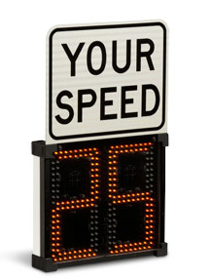
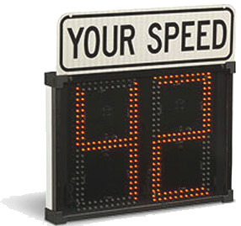
SHIELD 12 AND SHIELD 15
RADAR SPEED SIGNS
Digit Size: 12” MUTCD compliant
13.5” H x 15.5” W x 2.6” D
12 lbs. including mount
Battery and solar power options
Digit Size: 15” MUTCD compliant
17” H x 24” W x 2.6” D
18 lbs. including mount
Battery, solar and trailer power options
Notes:
Thanks Corey.

Slide 36
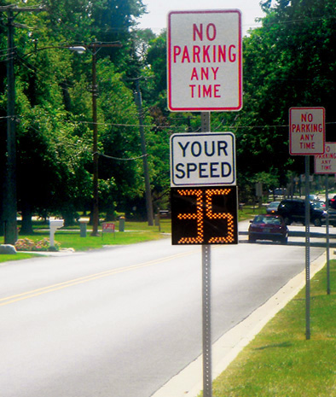
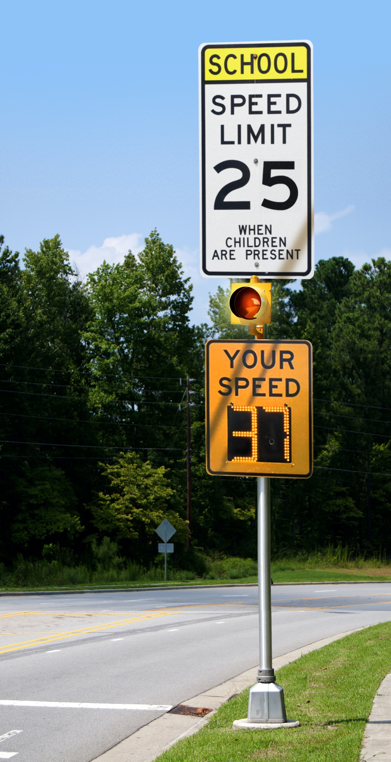
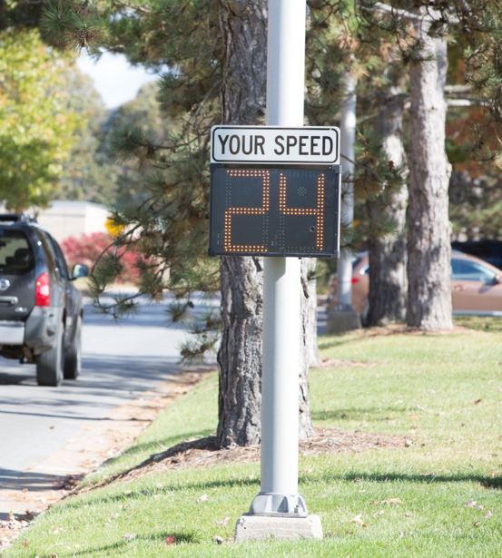
SHIELD USES INCLUDE
Speed awareness on roads and in school zones
Resolve speeding complaints
Stealth speed studies
Benchmark speeds in stealth mode before turning on sign
Gather data to show the results of your traffic safety program
Prove the need for speed limit changes
Improve community relations (they see the sign, know you’re taking an active role in safety)

Slide 37
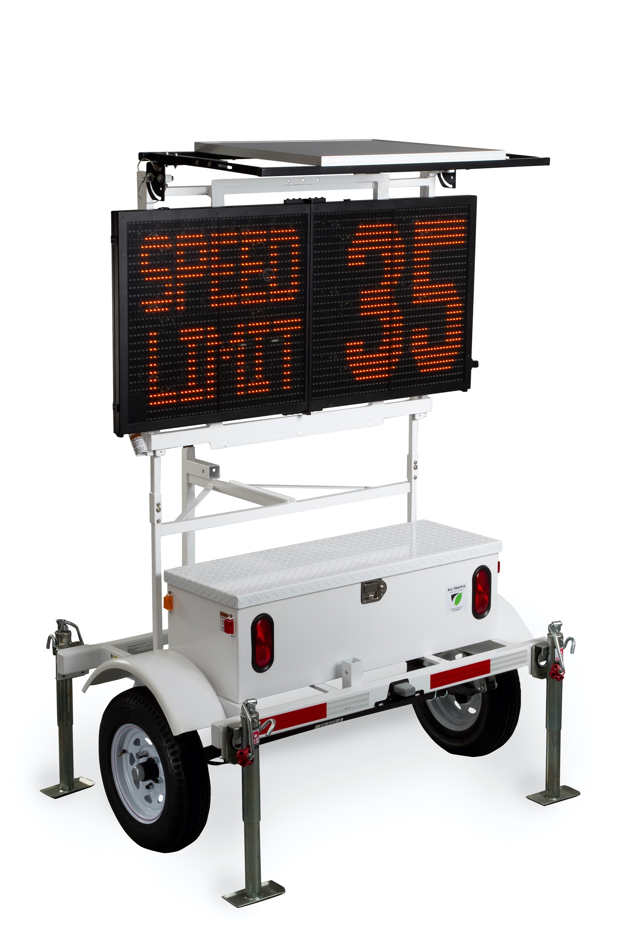
SPEEDALERT
RADAR MESSAGE SIGN
Text: 1 line; 4 characters; 24” H
Text: 2 lines; 8 characters; 11” H
Text: 3 Lines; 12 characters; 7” H
28” H x 60” W x 1.6” D
43 lbs.
Optional strobe bar

Slide 38
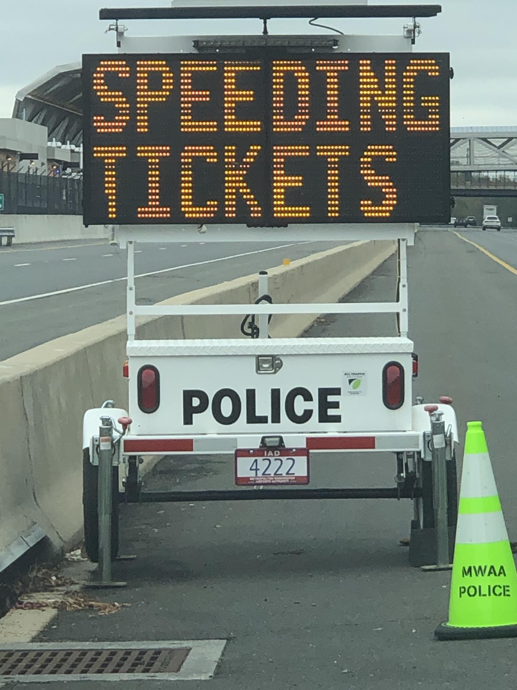
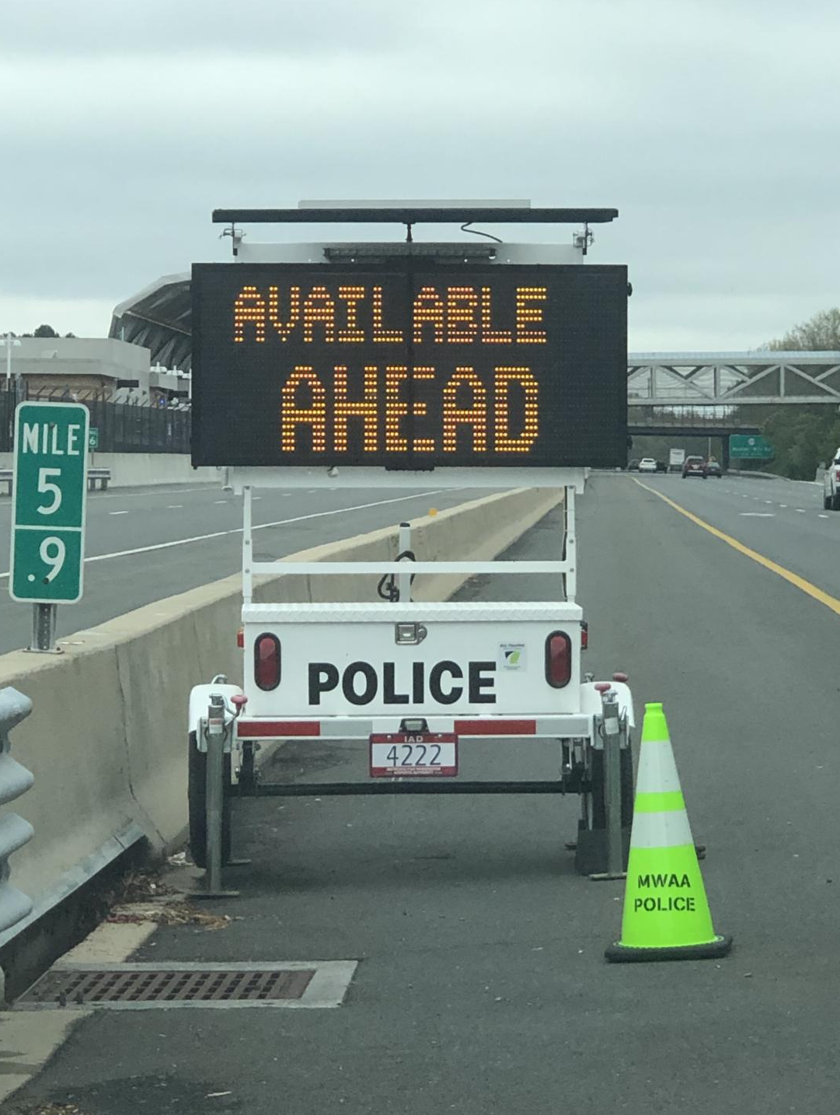
MULTIPURPOSE USES
Radar Feedback
Variable Message Sign
Traffic calming
Speed awareness
Resolving speeding complaints
Quick speed studies
Gather data to show results of your traffic safety program
Show your commitment to community safety
  Reroute traffic around accidents and congestion
  Emergency alerts
  Public safety information
  Events
  Direct people to parking
  DUI stops
  Road closures

Slide 39
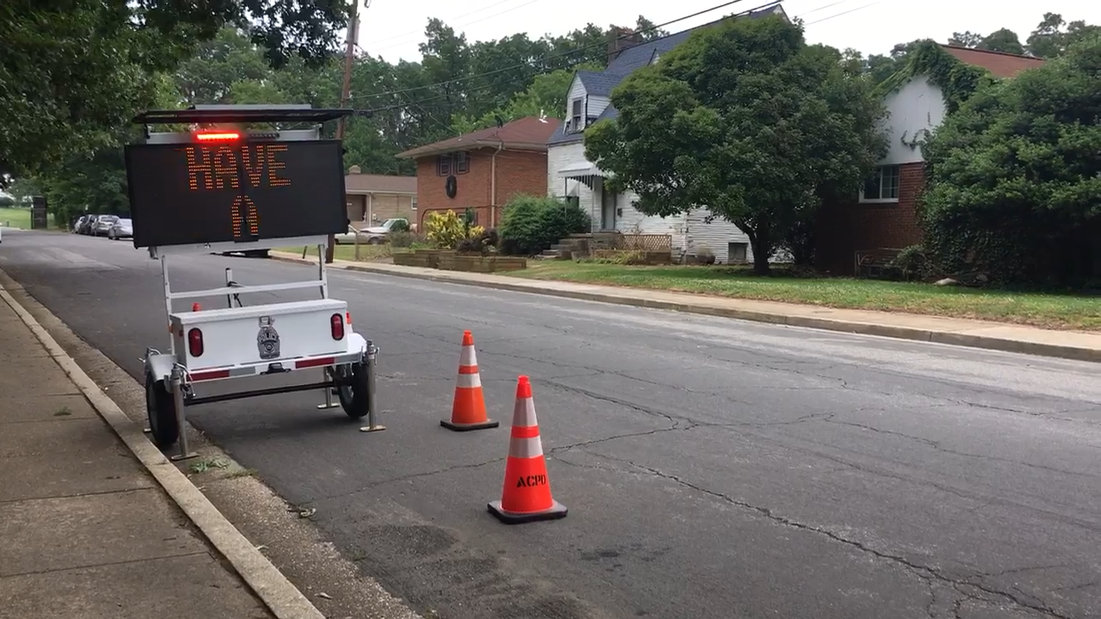
SPEEDALERT
RADAR MESSAGE SIGN

Slide 40
QUESTIONS?
Submit via the Chat box on your control panel now.
Notes:
That concludes the presentation portion. We have time for a few questions. You can use the chat box at the bottom of your screen to submit your question now.
If we don’t get to it now, we will contact you afterward. The first question is “How frequently is data uploaded from the sign to TraffiCloud”? Andy?
“How easy is it to run reports and how long does it take?” Corey, want to take this one?
(James I will ping you questions we actually get. If you don’t get a text, assume there are none and conclude the webinar.)

Slide 41
THANK YOU
(866) 366-6602
sales@alltrafficsolutions.com
Notes:
James: This concludes today’s webinar. You will receive an emailed link to the webinar recording tomorrow. Again, thank you for joining us.

