Slide 1
All Traffic Solutions
Intelligent Transportation Solutions for a Connected World

Slide 2
All Traffic Solutions
The Traffic Management Platform of the Future
  Traffic Flow-as-a-Service
  Real-time adaptive traffic solutions
  Descriptive, predictive & prescriptive analytics
  Intelligent Mobility
  Advanced road-user communication
Connecting the fixed
infrastructure to drivers to provide the right information to the right person at the right time
Notes:
Connecting the world’s traffic infrastructure to enable happier, healthier, greener communities
Connecting orgainizations to the technology they need to solve their most complex traffic challenges

Slide 3
Our Team
JIM WEAVER
Chief Executive Officer
20+ years directing management, finance, sales, and operations within turnaround and growth organizations
TED GRAEF
JOE GRABIAS
Founder & Chief Operating Officer
Chairman of the Board
ATS Founder; unparalleled industry knowledge and entrepreneurial background
15 years with Transcore as CFO and Executive Vice President
ANDY SOUDERS
CTO, SVP Engineering
25+ years of experience with a proven track record of growing businesses through innovation, building high performance teams and results-focused delivery.
SCOTT BELCHER
MIKE FARLEY
Advisor
VP, Sales
Established Intelligent Transportation Systems Leader. Former CEO of ITS America
Deep experience in executive sales and business development at diverse, fast–growing SaaS startups
INGA BROERMAN
Chief Marketing Officer
Strategic marketing leader with extensive brand and demand generation expertise at B2B technology firms and SaaS companies.
Notes:
Senior Executive with over 25 years of experience in the internet, e-commerce, retail, manufacturing and financials services sectors. Strong technical foundation coupled with expertise in business development, sales and marketing and mergers and acquisitions. Proven track record of growing and scaling businesses through innovation, building high performance teams and results-focused delivery.

Slide 4
The Leading Innovator In Cloud-Based Traffic Management
Top Of Mind and First On The Road
  Leading the way in sensor-driven transportation. Leveraging IoT to
  manage traffic, build intelligent systems and support ‘smart’ cities
  Recognized as the leader in data-driven traffic management solutions
2003
First portable
pole-mountable speed display sign
2005
First changeable
message sign with Bluetooth capabilities
2007
First cross-product communication
2010
First web-based traffic signs
2013
First to patent
cloud-based traffic data collection
2016
$8M in Series A funding, appoints Jim Weaver CEO
2004
First folding changeable
message sign
2006
First remote-
access traffic
safety signs
2008
First ultra-portable
speed display sign
2012
First industry-wide trade-in program
2014
Introduction of TraffiCloud™ web-based ecosystem

Slide 5
A Single, Better Platform
Work with any sensor or external data without complex
multiple integrations
Platform
From any roadside sensor or external data set…
…a Holistic View of Road, Environ-
mental, and Facility Conditions
Open, Interoperable

Slide 6
How We Do It
A Simple But Comprehensive Strategy For Better Safety and Control
Instrument
Communicate
Add any existing or future device to your wireless network
Remotely access, monitor and manage all connected devices
and dynamic messages from
one central location
Report
Analyze
View dashboards and reports from one, many
or all traffic devices
More insightful decisions
based on data analytics from
all your program components

Slide 7
Ready for an Increasingly Autonomous Future
TraffiCloud gives you the power to integrate across 1,000s of sensor networks
Simple to connect all physical sensors and dynamic
message signs
Open, flexible platform
Extensible to any sensor
or data set
Existing network of over
3,500 customers
Complex conditional
messaging capabilities
Over 5,000 connection-ready sensors and dynamic message signs in the field
Easy to implement

Slide 8
Traffic Flow-as-a-Service
Congestion Management
Parking
Putting all the Pieces Together for Better Traffic Management
Integrated traffic sensor, notification system and parking management to solve traffic challenges
Virtual Traffic Flow analysis
Time-to-destination & virtual drive times
Real-time availability management and wayfinding
On-demand reporting and analytics
Integration with external systems and databases for comprehensive parker management
Roadside Messaging
Traffic
Safety
Vehicle Count
& Classify
Integrate sensors to provide real time notifications to drivers
Pre-programmed messages
Variable messaging based on driver speed, direction or other inputs
Wrong Way Detection & Notification
Radar speed enforcement
Real time data and reports for speed limit optimization, enforcement priorities and program success
Pedestrian & workzone safety
Detect lane, speed and class of individual vehicles
Non-invasive sensing technology
Remote access to data from any
connected device for hassle-free traffic studies

Slide 9
An IoT-driven approach to every problem
Traffic congestion and bottlenecks, with limited ability to redirect traffic through current messaging systems.
Adaptive traffic flow
(Monitor, Alert and Notify)
PROBLEM
SOLUTION
No real time way to redirect traffic, especially freight, based on events or congestion.
Virtual Drive Times and conditional messaging
PROBLEM
SOLUTION
Limited quantitative data on volumes and what routes are being used the most
Real time counts and classification
PROBLEM
SOLUTION
Unknown inventory at truck stop rest areas and no automated gate in/gate out for freight.
Parking availability & dynamic notifications
PROBLEM
SOLUTION
Road safety concerns, especially for workzones and wrong way drivers.
Wrong way and workzone safety protections
PROBLEM
SOLUTION

Slide 10

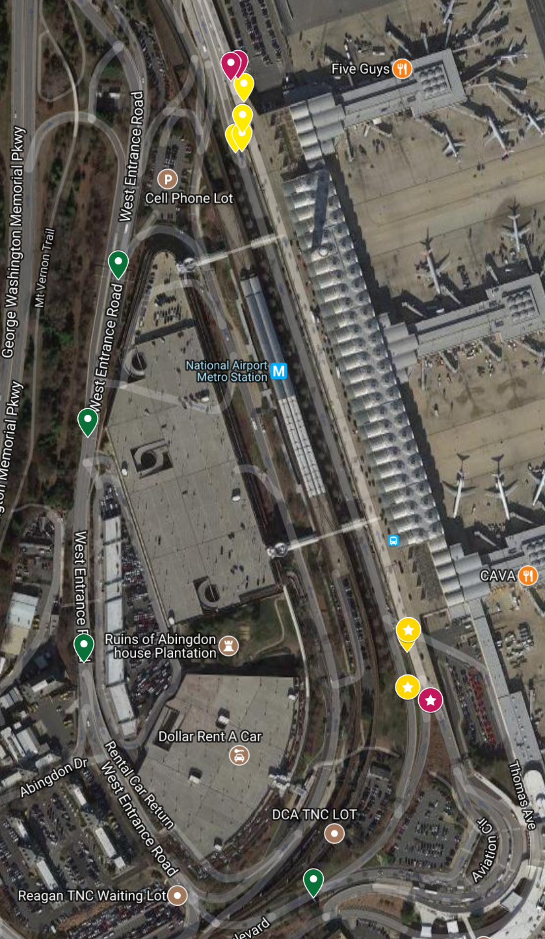
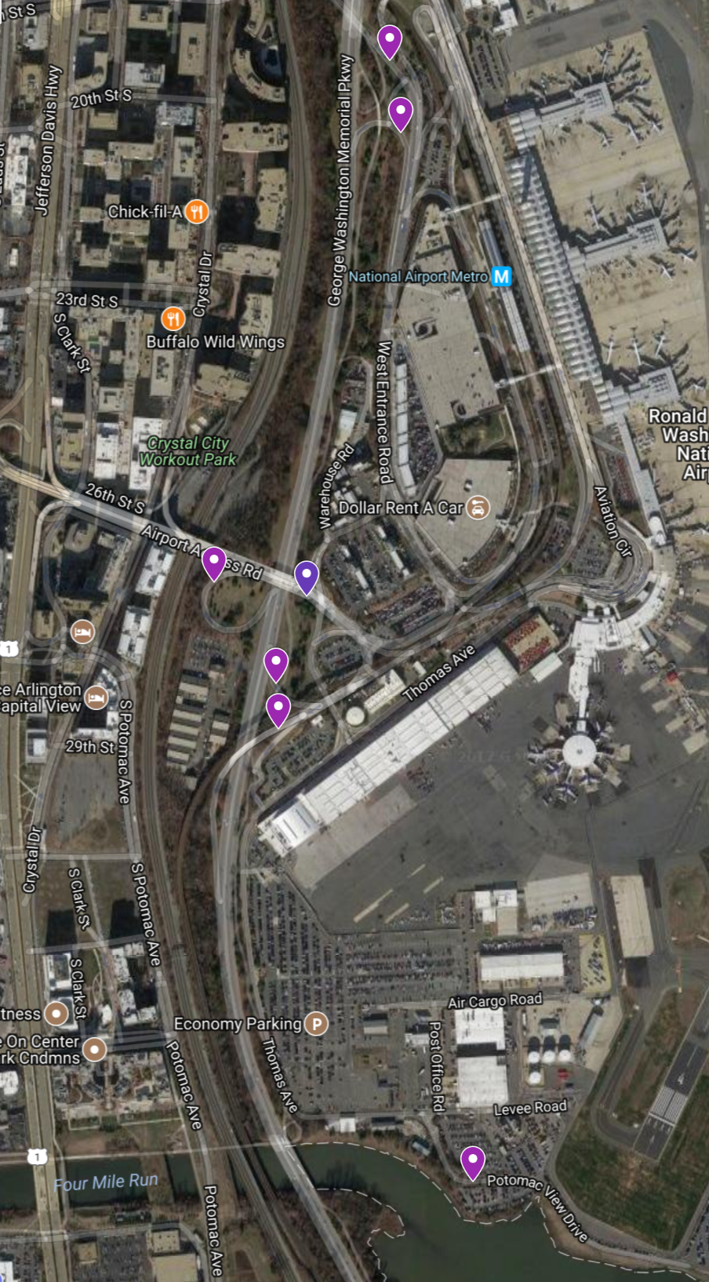

Adaptive Traffic Flow with Conditional Messaging
Informing drivers in real time of fastest time to destination
Based on live GPS data and roadside traffic sensors to alleviate congestion

Slide 11
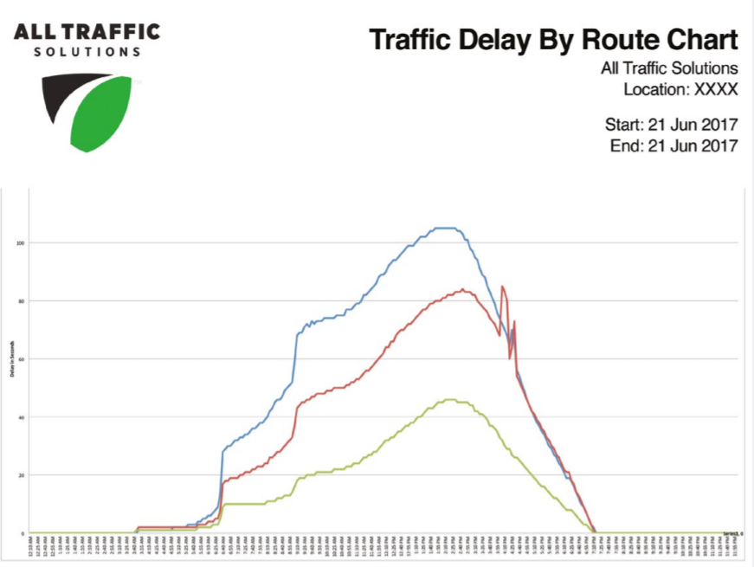
Virtual Drive Times & Flow Analysis
Leverage Traffic and Queue counting technology to notify travelers of the Time to Destination in real time
Use fixed and portable variable message signs to dynamically route traffic through identified choke points based on optimal time to destination

Slide 12
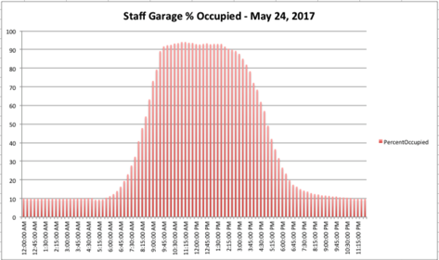
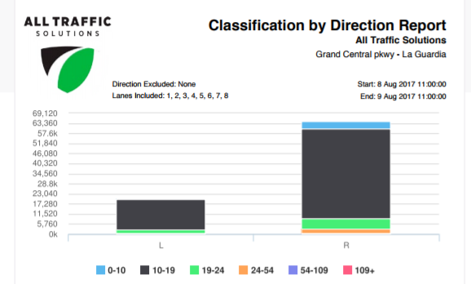
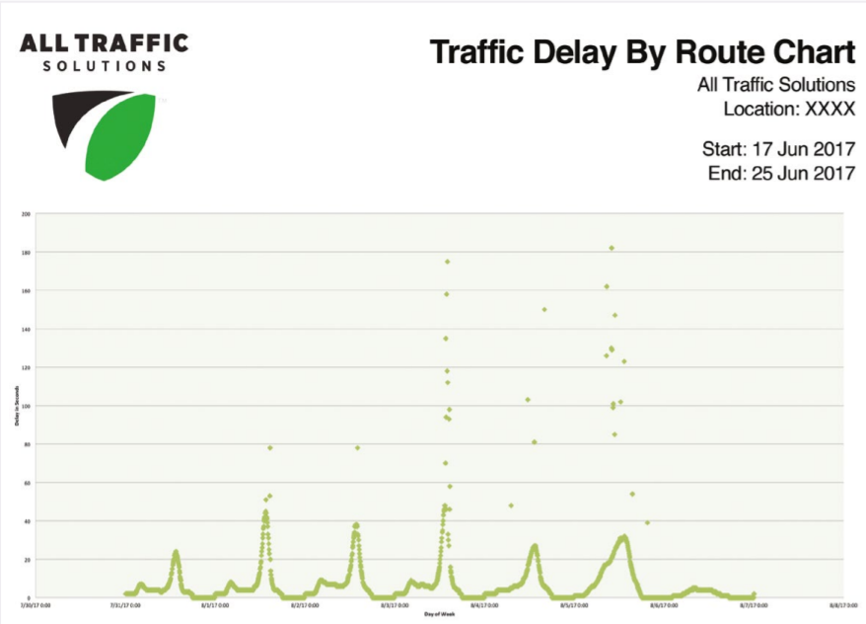
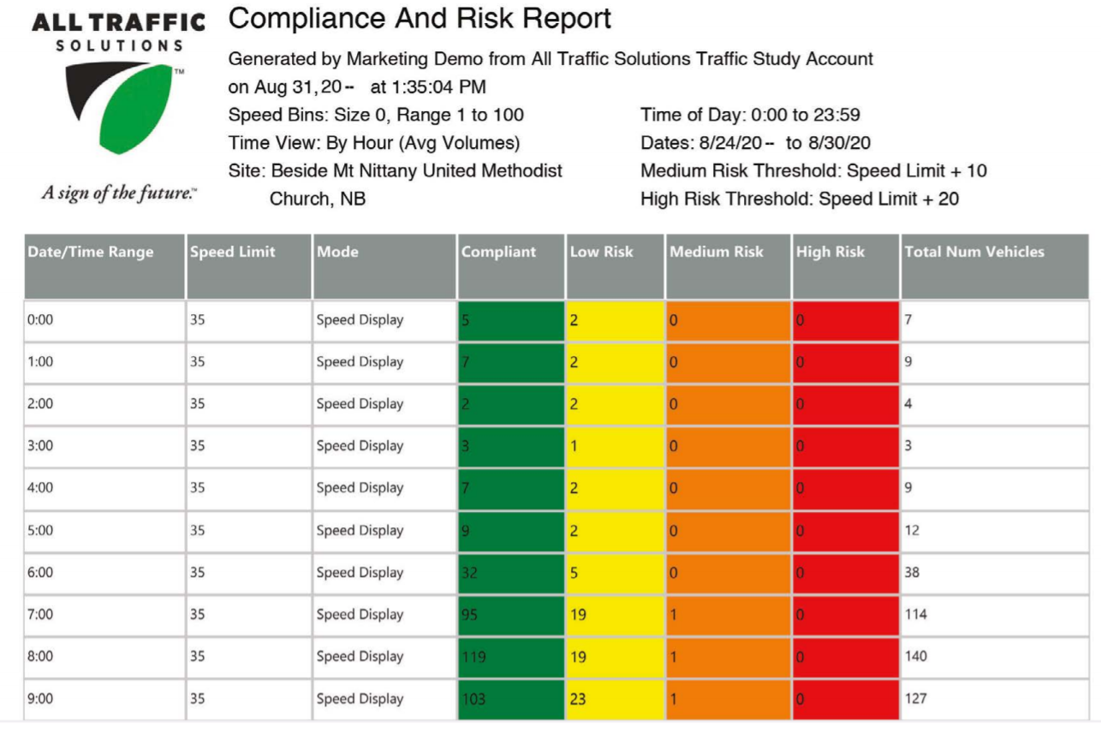
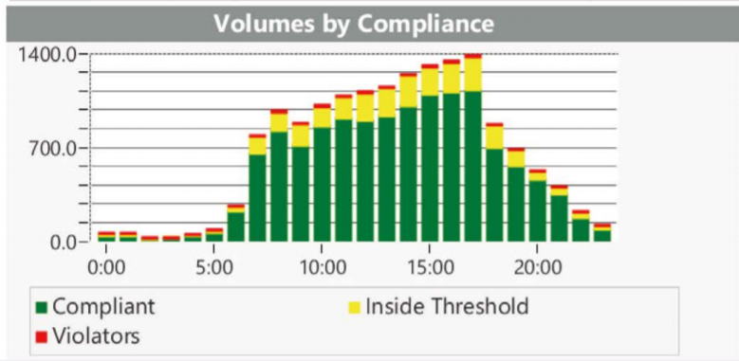
Real Time Data & Analytics
The data you need to make informed decisions
Counts and classification from each specific entrance and exit
Ready made reports at your disposal

Slide 13

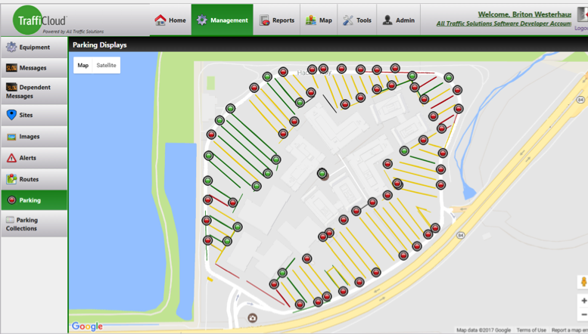
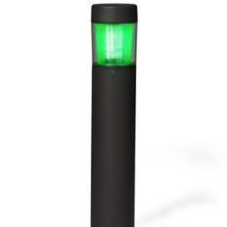
Parking
Notes:
Images

Slide 14

Trucking & Logistics
12
Carriers/Drivers spend less time sitting idle – with ELD, drive-time will be even more critical
Lower base rates; lower demurrage/detention costs
Smaller footprint (fewer dock doors, smaller marshall yard, smaller acreage, etc)
Redirecting truckers to Truck-Stops when load isn’t ready
Paid reservations
FastPass for truckers with hot-shipments
Smarter pre-staging of cargo; Smarter scheduling and execution of Delivery Windows
Shippers become preferred users and higher-ranked by future Uber-based truckers
Reduce traffic congestion outside of your shipping facility
Reduce air pollution and improve safety
11
10
?
?
9
?
?
?

Slide 15
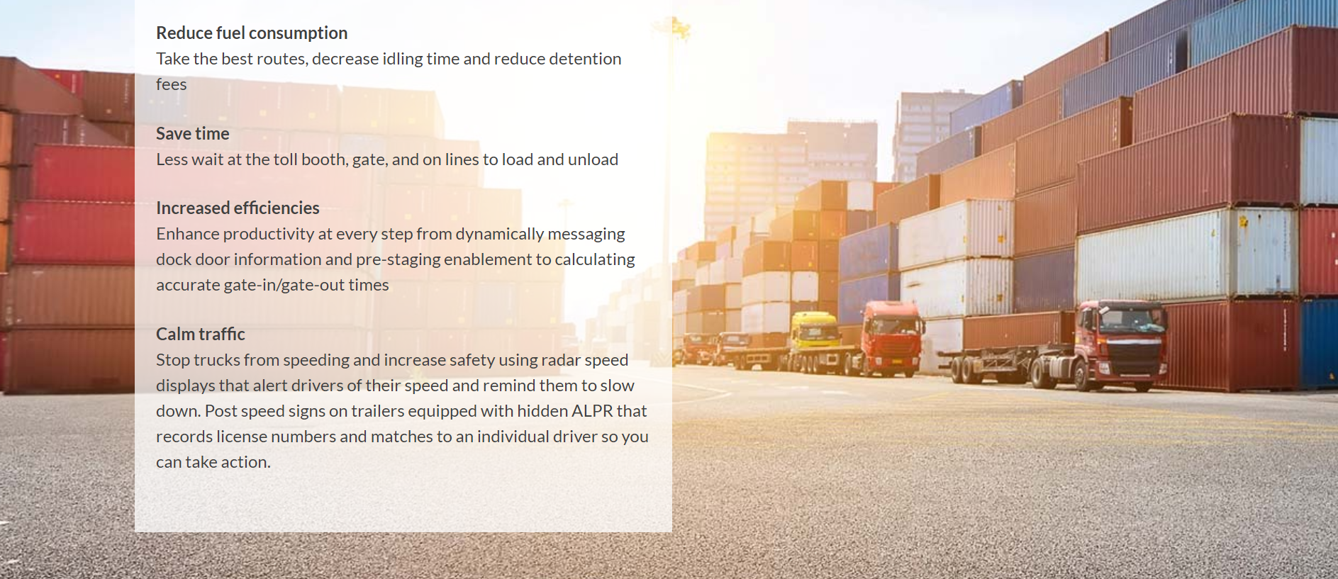
Freight Transport Optimization

Slide 16

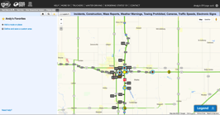




Wrong Way Solutions – no “one size, fits all” solution
SENSE
HTTP Push
PREVENT
TraffiCloud Gateway (TCG)
NTCIP
HTTPS
Warn drivers via Waze CCP, SMS, EBS
Define protocol standards
API
Remote Management
Reporting
Analytics
RESPOND
HTTPS

Slide 17

The All Traffic Advantage
Why TraffiCloud Is the Better Intelligent Traffic Management Solution:
1
2
  Single view into total traffic ecosystem
  Future-proof open, agile, extensible platform
3
4
  Accommodates existing infrastructure
  Cloud-based SaaS and PaaS economies

Slide 18
Thank you.

