Slide 1
ALL TRAFFIC SOLUTIONS
™
TRAFFICLOUD
FOR MUNICIPALITIES

Slide 2

ABOUT ATS
Industry-leading solutions for traffic management, parking availability, speed enforcement & intelligent messaging
Patented TraffiCloud™ online traffic management solution provides reports & analytics via remote access from any Internet-connected device
Open, flexible, secure & scalable cloud-based solutions
Data & analytics available on-demand 24/7:
  Manage & communicate parking availability
  Optimize resource utilization
  Improve safety and customer satisfaction
All products engineered & built in USA
Notes:
First, just a brief introduction to our company. You might know us for our traffic signs, which are engineered and built in the USA and quality is excellent. But what makes us different is the cloud-based component. First, you can manage all your devices from your computer, tablet or smartphone. You can change the messages on any or all of your signs, change the setting, -- you can download traffic data from all your devices, and run reports & analytics from anywhere 24/7. The value of our data is that reports are all generated for you – no complicated raw data to compile. You plug in your date ranges, select your device locations and go.
With just a few clicks – you can track all your show the success of your efforts, problem areas, resolve complaints.

Slide 3
TRUSTED BY 5,000+
Municipalities, Law Enforcement Agencies, Commercial Organizations & More
in all 50 States and 20 Countries
Law Enforcement
Facility Safety
Safety Planning
Public Works
Emergency Management
Transportation Departments
Large Public Venues
Urban Planning
Traffic Engineering
Corporate Campuses
Notes:
Our customers include municipalities, law enforcement agencies, as well as commercial organizations. Often, public works departments and law enforcement work together and with other organizations in the community. For example, depending upon who has the budget, one agency buys the signs but they share the data gathered from the signs. Or law enforcement recommends our speed sign to HOAs. For example, in Montgomery County Maryland, as part of their Vision Zero program, HOA’s purchase our Shield radar displays and provide access to the Montgomery County Police Department so they both can monitor traffic in the area.
****FIND YOUR OWN EXAMPLE OF CUSTOMERS WHO ARE CLOSE IN PROXIMITY TO YOUR PROSPECT -– this is what Mayberry did in their area and what signs they have.)
****If you have time to prepare, Google the organization and see if they have parking decks, fairgrounds, hospitals, event areas, universities, airports. See how much info they will sharer with you because they know the players in the community.

Slide 4




CUSTOMERS INCLUDE
Notes:
We’ve established our reputation in the industry by serving the traffic needs of municipalities and law enforcement, and our products were designed for you. We also work with hospitals, airports, major corporations, parking facilities, and even sports teams.

Slide 5

TraffiCloud
Real-time data and device monitoring for up-to-the- minute information and access
All your data in one secure cloud-based solution, accessible from one interface
2
1
Open, flexible, scalable architecture that integrates with your existing solutions
Remote access to equipment saves time—manage all connected devices (regardless of manufacturer) and dynamic messages from one central location
3
4
Easy-to-use dashboards and reports of all collected data so you can make more insightful decisions based on data analytics from all your program components
5
Notes:
Benefits for PW are:
TraffiCloud is a web-based traffic management ecosystem that lets you access, monitor and manage all your traffic devices and data from one central online location, using any Internet device. This means you can use your laptop, phone or tablet to log into TraffiCloud from anywhere 24/7 and do a whole range of things:
Download data and reports from all your devices from any Internet connection, -- to one central database you assess from a single easy to use interface.
Reports include average speed, 85th percentile, volume by speed compliance level, enforcement prioritization report
You can combine your count and classification data with your speed data for traffic studies
You can also change the messages on your variable message signs whenever you need to.
Monitor battery levels from your radar displays, variable message signs and count & classify devices -- without driving out to each one
Check the location of each device using GPS
Make sure your signs have not been tampered with
You get all this information right on your home screen!
Not only do we connect all your ATS devices, we can connect your devices from other manufacturers as well – to build your traffic management ecosystem of the future. So if you have been putting off device purchases because you’ve been concerns that they won’t be able to talk to each other, now you can!

Slide 6

WHAT WE DO FOR
MUNICIPALITIES
Provide accurate, relevant real-time data & analytics for traffic studies & proactive planning
Leverage traffic management, work zone safety, roadside messaging & speed enforcement solutions to keep roadways safe & manage traffic flow
Parking availability & notification solutions to reduce traffic congestion
Help make your city more attractive to business, visitors & citizens
Notes:
We help municipalities and public agencies keep citizens, workers and drivers safe, optimize your resources and measure the results of your traffic safety initiatives by making your traffic devices, as well as data and analytics accessible and manageable in the Cloud. So you can see that we do way more for you than just make high quality traffic signs.

Slide 7

SOLUTIONS FOR MUNICIPALITIES
Connected Solutions for Better Traffic Safety Outcomes
TRAFFIC CALMING
PARKING
MESSAGING & NOTIFICATIONS
Real-time parking availability management including level counts; parking data, reporting & analytics; parking availability notification; interactive mapping; integration with employee, vendor, student or other database for access control & mass notification
Radar speed enforcement; school zone safety, remote diagnostics; TraffiCloud enabled for remote management; data & analytics for speed limit optimization, enforcement priorities, 85th percentile & program success
Conditional sensor messaging; dynamic messaging from TraffiCloud including variable messaging based on driver speed; flexible special event & pre-programmed messaging; portable or fixed with multiple power options
COUNTING & CLASSIFICATION
TRAFFIC MANAGEMENT
Count & classify vehicles with turnkey, non-invasive sensing technology; four, six or eight lane bidirectional data gathering; multi-purpose radar speed signs
Wrong way notification systems, event-based & conditional sensor messaging; traffic safety in pedestrian or work zones; Time to Destination & Virtual Drive Times
Notes:
When you use our products together you have real solutions for traffic safety and traffic calming, speed enforcement and roadside messaging. Here are some examples. (Point out the ones most relevant to your prospect)

Slide 8
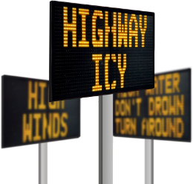
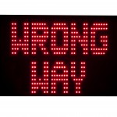
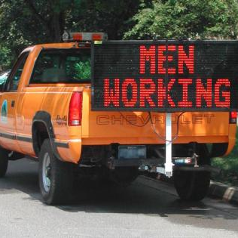
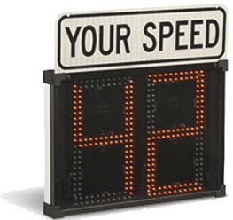

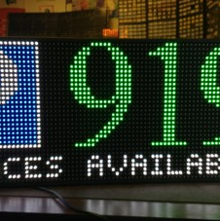
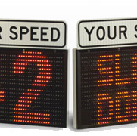
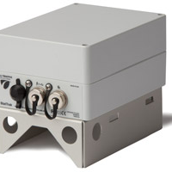
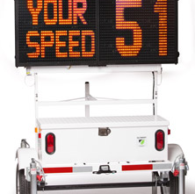
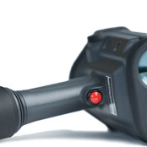
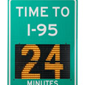
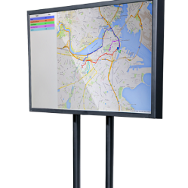
PRODUCTS FOR MUNICIPALITIES
1
2
3
4
5
6
Conditional Messaging
Wrong Way
InstAlert 18/24
Shield 12/15
SpeedLane
Parking Availability Messaging
7
8
9
10
11
12
SpeedAlert 18 / 24
StatTrak
ATS 5 Trailer
DragonEye Lidar
Time to Destination
Virtual Drive Times
Notes:
We engineer and manufacture radar speed displays, portable variable message signs and counter classifiers. All are web-enabled and are TraffiCloud-ready. Here are some of our products.

Slide 9

WHY ALL TRAFFIC SOLUTIONS?
All our devices are completely cloud-enabled
Remote access to data and devices from any Internet-ready device
Full suite of radar displays, variable message signs, speed enforcement tools, counter classifiers, trailers/mounts
Engineered and manufactured in
the USA
Industry-leading warranty
Notes:
Here are some of the reasons that municipalities trust us with their traffic management needs - We help you keep citizens, drivers and pedestrians safe, optimize your resources, save money by automating traffic management, and measure the results of your traffic safety initiatives.

Slide 10
TRAFFICLOUD

Slide 11
TOTAL TRAFFIC MANAGEMENT
1
2
3
Equipment Management
Alerts
Reporting
4
5
6
Imaging
Mapping
Enforcement
7
8
Parking
PremierCare
Notes:
TraffiCloud is a centralized, web-based ecosystem that lets you access, monitor and manage your traffic devices and data from one central location

Slide 12
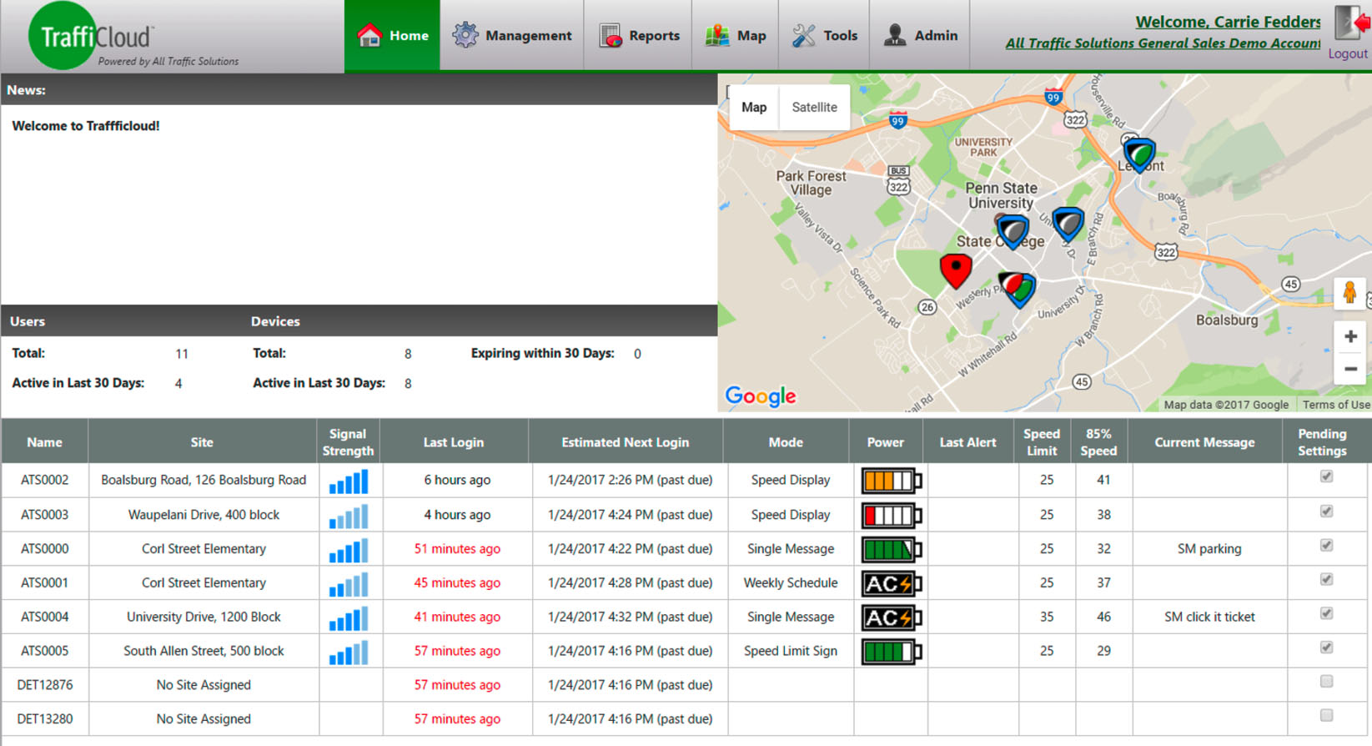
HOME SCREEN
Notes:
This is the TraffiCloud home screen. This is the first thing you seen when you log in – all your important device information and statuses on one screen.
The home screen shows a Google map of all your traffic devices – so you see the location of all your variable message displays, radar speed signs and count & classify devices, and you can click on each one to drill down.
As you look below the map, you see each of your devices listed, along with location, your last login to the device, what mode each device is currently set to, the battery power of each device, speed limit and 85% percentile for the device if applicable, the current message and the pending settings.

Slide 13
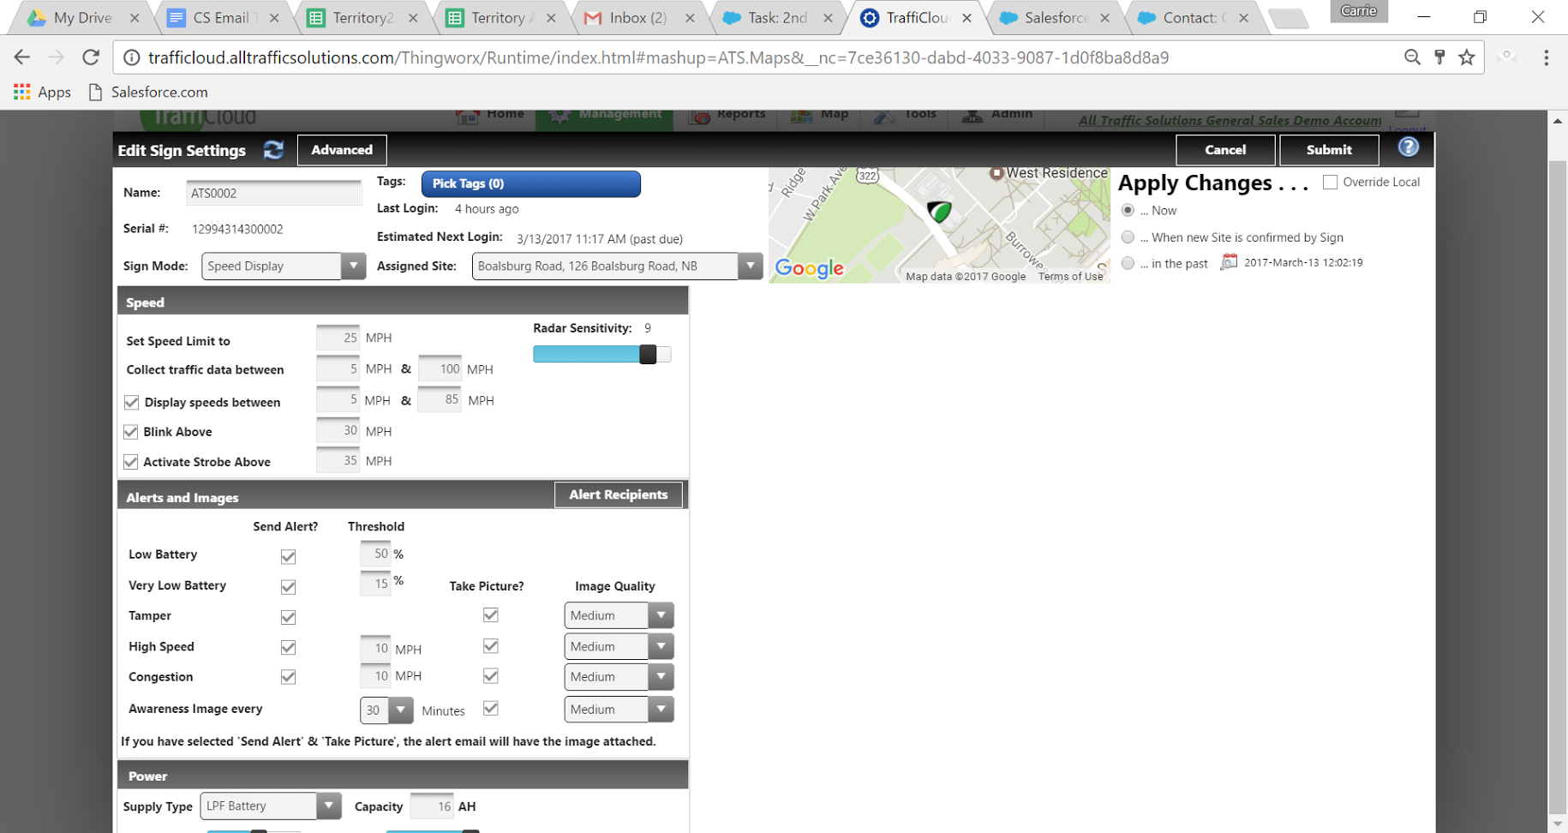
SETTINGS AND ALERTS

Slide 14
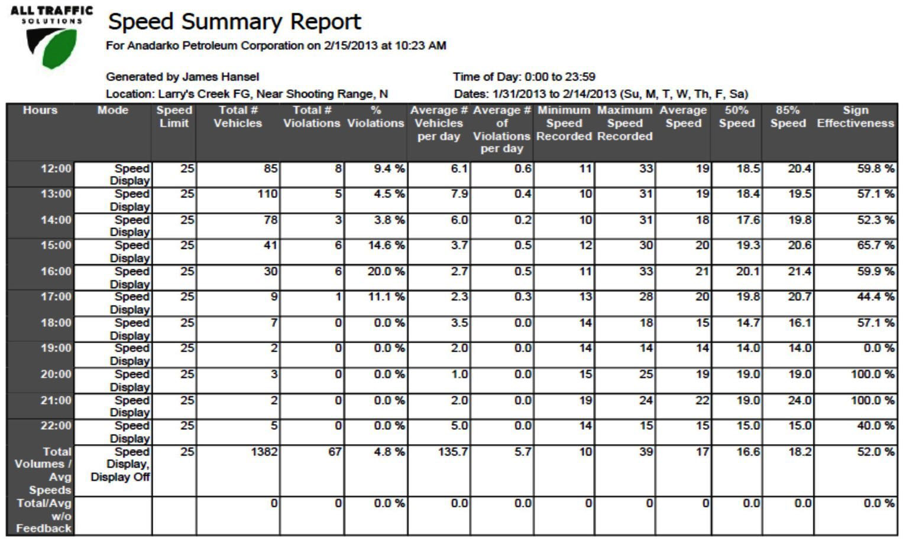
REPORTS

Slide 15
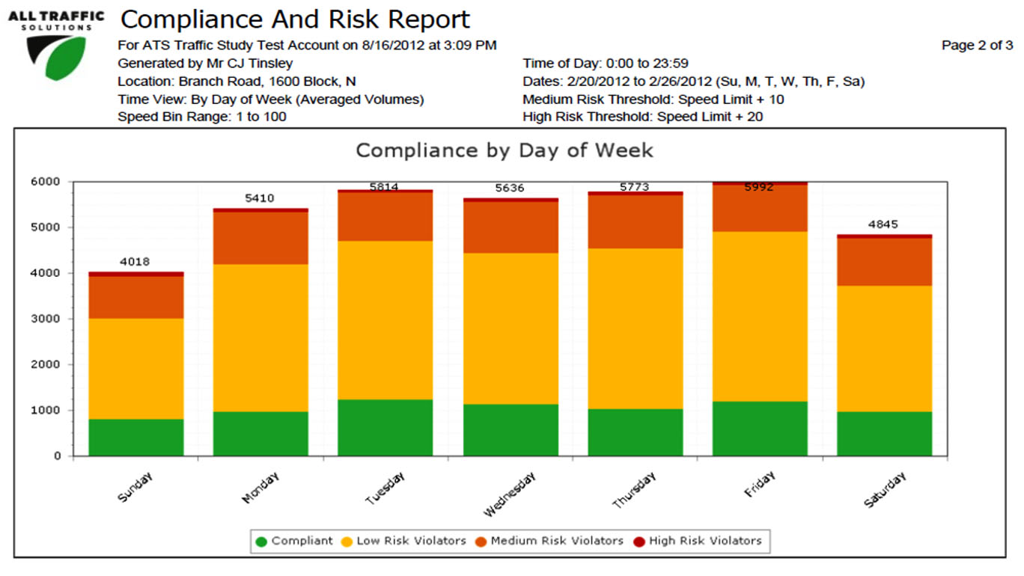
REPORTS
Notes:
This is the Compliance and Risk report, which charts for you, by day of the week, the number of drivers who are violating the speed limit, whether they are low, medium or high risk. The green portion shows the number of compliant drivers. You can also run this report for one particular day of the week, and view violations by hour.

Slide 16
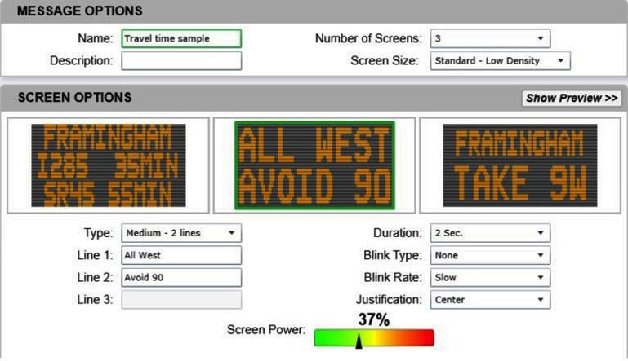
MESSAGING
Notes:
This is a TraffiCloud screen displaying three screen options on an InstAlert variable message display. You can set the duration, blink type and blink rate of each message, and adjust screen power. You can change the messages, including the number of lines of text, the duration of each message before it changes, and which signs carry which messages. You can also change the message on every sign to the same single message and have it display in under a minute.

Slide 17
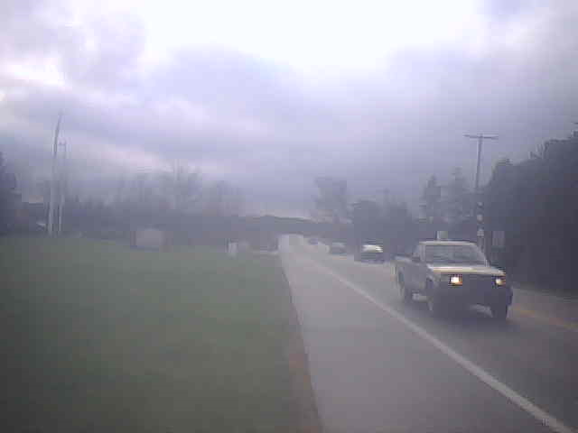
SETTINGS
Custom Automated Email Alerts
---------- Forwarded message ----------
From: <alerts@alltrafficsolutions.com>
Date: Tue, Nov 29, 2016 at 3:34 PM
Subject: Alert!
To: xx@intuitivecontrols.com
A vehicle travelling 53 passed Beside Mt Nittany United
Methodist Church at November 29, 2016 3:31:58 PM
UTC. The speed limit at this location is 25.
Notes:
You can set TraffiCloud to alert you via email of low battery, tampering, or for certain types of violations – as they happen. You set the threshold for alerts, and can change the recipients of these alerts at any time you choose.
Here’s an example of an email alert for a vehicle that passed a radar speed display going more than twice the speed limit.

Slide 18

SIGN SETTINGS & ALERTS

Slide 19
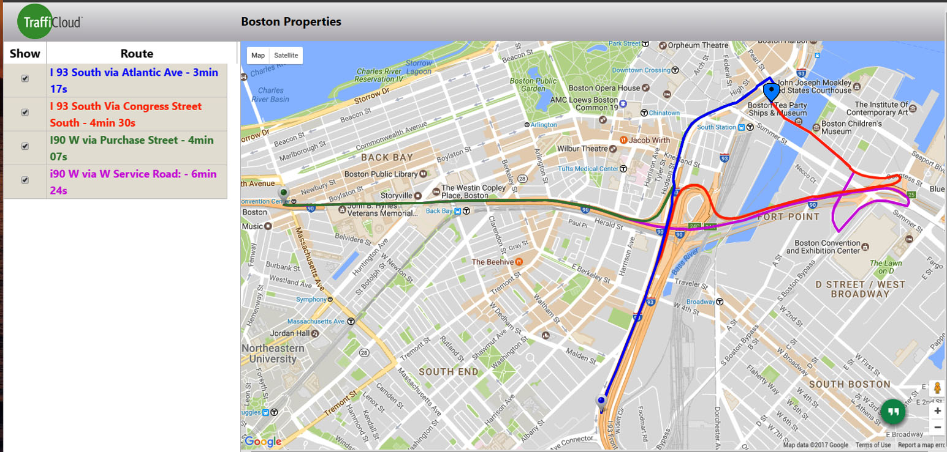
VIRTUAL DRIVE TIMES

Slide 20
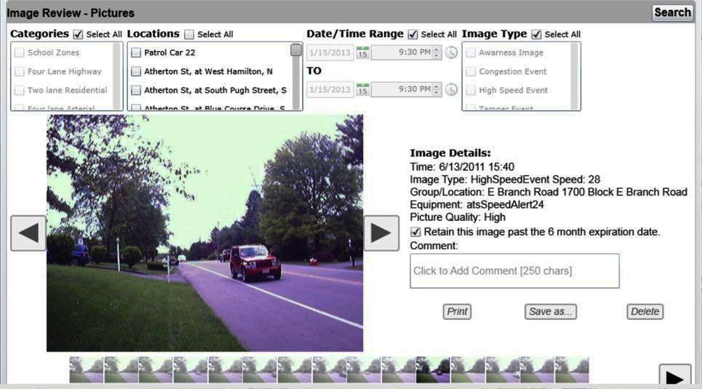
IMAGES

Slide 21
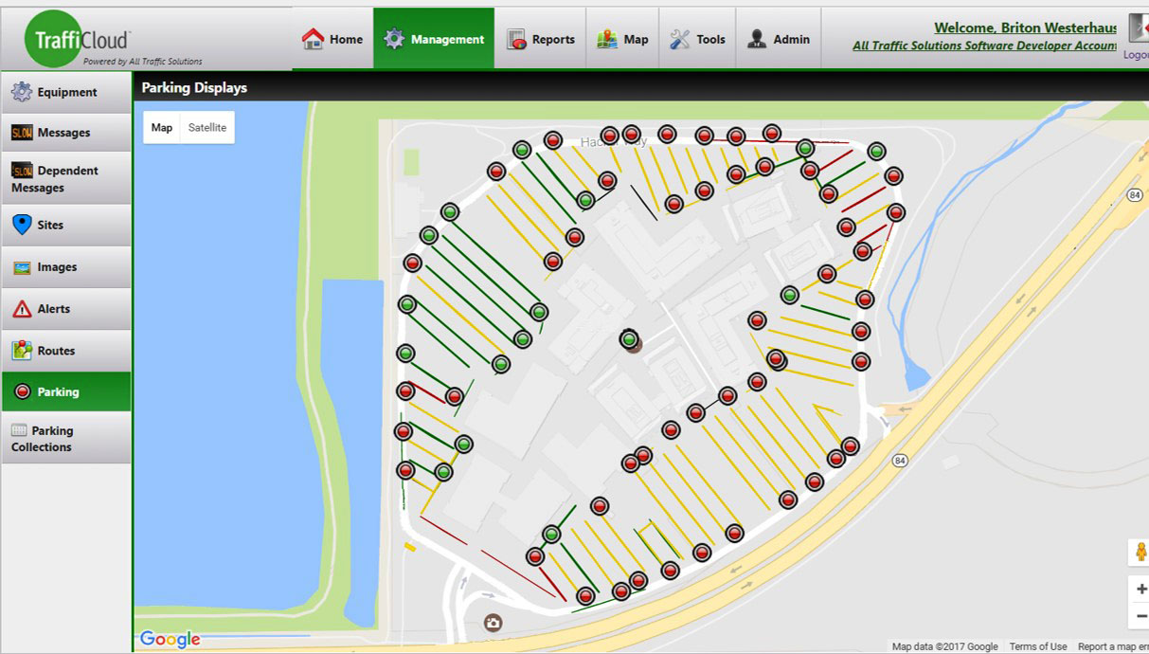
PARKING
Monitor and notify drivers of parking availability using maps that update information every 30-60 seconds
Notes:
Our GPS mapping is great for parking lots and parking facilities as well. Here, you can see by row, which rows of a parking garage have available spaces by the red and green circles. You can use this information to notify drivers at these facilities about where to find available parking spaces. We can also install red and green LED bollards at the end of each row in the parking garage to let drivers know whether the row has spaces available so they can park faster and reduce congestion.

Slide 22
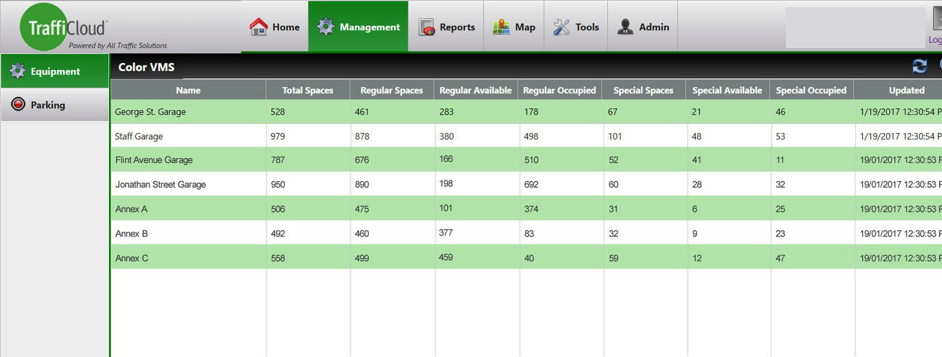
PARKING
Parking Management Dashboard displays availability at all facilities for immediate comparison
Notes:
This report shows the available spaces by parking facility, including regular and special spaces set aside for handicapped parking and for expectant mothers.

Slide 23
MANAGE EVERY COMPONENT
Of your traffic safety program
1
2
3
4
View dashboards & reports of all collected data, or just one traffic device
Make more insightful decisions based on data analytics from all your program components
Remotely access, monitor and manage all connected devices & dynamic messages from one central location
Improve workflows, reduce person hours & optimize resources
Notes:
To sum it up, TraffiCloud lets you manage every component of your traffic safety program: fast access to data and reports for insightful decision making, and remote access to your devices to optimize your resource.
So now that you’ve seen a little about all TraffiCloud can do for you, which features do you think would be most beneficial to you?

Slide 24

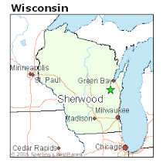

WHAT OUR CUSTOMERS ARE SAYING
The data is phenomenal.
My only regret is that we did not start using it sooner.”
The metrics the signs pull from the various reports available are becoming a guiding document for our Traffic and Speed Safety Compliance Program. I am thrilled to have my data back in hand as it is needed on-demand.
One of the advantages of the Android app is that I can ensure that my unit is working properly without driving to the device.
Traffic Sergeant, Laguna Beach Police Department
LeAnn Blankenship, Missouri Dept. of Transportation (MoDot)
David A. Tomlin, Site Security Lead, Dupont

Slide 25
THANKS!
emailexample@alltrafficsolutions.com
(###) ###-####

