Slide 1
ALL TRAFFIC SOLUTIONS
™
TRAFFICLOUD
FOR LAW ENFORCEMENT
Notes:
You have them on the phone.
If customer: how are you using or would like to use your signs?
C/P: If budget was not a concern, we work with lots of LE you don’t know if you have budget or grant, but putting that aside – what do you have challenge wise or initiatives that you’re focused on. What would your ideal situation be?
Prospects are thinking more of price – how much it’s gonna cost – what’s your goal – your problem area. So she can reference that info during the demo. Do they think about data or reporting back to the mayor. So she knows how to focus the conversation – info gathering.

Slide 2
ABOUT ATS
Industry-leading solutions for traffic management, speed enforcement, roadside messaging & parking availability
Patented TraffiCloud™ online management solution provides reports & analytics via remote access from any Internet-connected device
Open, flexible, secure & scalable cloud-based solutions
Data & analytics available on-demand 24/7:
Optimized resource utilization
Resolve complaints
Improve safety & traffic calming
All products engineered & built in USA
Notes:
First, just a brief introduction to our company. You might know us for our traffic signs, which are engineered and built in the USA and quality is excellent. But what makes us different is the cloud-based stuff. You don’t have to drive to the sign. Do it all from your desk – save time. The value of our data is that reports are generated for you – no complicated raw data. Resource prioritization report, other reports all with just a few clicks – show the success of your efforts, problem areas, resolve complaints.

Slide 3
TRUSTED BY 5,000+
Municipalities, Law Enforcement Agencies, Commercial Organizations and more
in all 50 States and 20 Countries
Law Enforcement
Facility Safety
Safety Planning
Public Works
Emergency Management
Transportation Departments
Large Public Venues
Urban Planning
Traffic Engineering
Corporate Campuses
Notes:
Our customers include not just law enforcement, but other agencies and organizations as well. They will typically work together with other organizations in the community municipality – for example, law enforcement often works with Public Works. Depending upon who has the budget, one agency buys the sign but they share the data that the sign gathers. Or law enforcement recommends our speed sign to HOAs. For example, in Montgomery County Maryland, as part of their Vision Zero program, HOA’s purchase our Shield radar displays and provide access to the Montgomery County Police Department so they both can monitor traffic in the area.
****FIND YOUR OWN EXAMPLE OF CUSTOMERS WHO ARE CLOSE IN PROXIMITY TO YOUR PROSPECT -– this is what Mayberry did in their area and what signs they have.)
****If you have time to prepare, Google the organization and see if they have parking decks, fairgrounds, hospitals, event areas, universities, airports. See how much info they will sharer with you because they know the players in the community.

Slide 4
CUSTOMERS INCLUDE
Notes:
We’ve established our reputation in the industry by serving the traffic needs of law enforcement, and our products were designed for you. But we also work with municipalities, hospitals, airports, corporations, parking facilities, and even sports teams.

Slide 5
TraffiCloud
Real-time availability and alerts keep you informed as situations change
All your data in one secure cloud-based solution that you access through a single easy-to-use interface
2
1
Easy-to-use dashboards and reports of all collected data so you can make more insightful decisions based on data analytics from all your program components
Remote access to equipment reduces time—monitor & manage all connected devices and dynamic messages from one central location
3
4
Notes:
TraffiCloud is a web-based traffic management ecosystem that lets you access, monitor and manage all your traffic devices and data from one central online location, using any Internet device. This means you can use your laptop, phone or tablet to log into TraffiCloud and do a whole range of things such as:
Monitor the battery levels on your signs, radar displays and count & classify devices without driving out to each one
Check the location of each device using GPS
Make sure your signs have not been tampered with
You get all this information right on your home screen!
You can also change the messages on your variable message signs whenever you need to.
You can also download data reports and analytics, such as average speed, 85th percentile, volume by speed compliance level. One report that our customers find really useful is the Enforcement Priorities Report that tells you, for any given site, the number of speed violations, average violation speed and 85th percentile speed by time and day of the week.
The Extended Speed Summary report shows what % of vehicles have slowed over time. Your chief will love it!
These reports come in very handy for clearing complaints from citizen and HOAs, and for demonstrating the results of your traffic calming efforts.
.

Slide 6
WHAT WE DO FOR
LAW ENFORCEMENT
Help keep drivers & pedestrians safe by making it easier to calm traffic & enforce speed limits
Provide relevant, real-time data to make proactive enforcement decisions
Help agencies optimize enforcement resources & reduce costs
Furnish reports to HOAs & citizens to demonstrate results of traffic calming efforts
Allow departments to understand & report on impact of traffic safety initiatives to clear complaints faster
Notes:
TraffiCloud helps law enforcement keep citizens and drivers safe, optimize your resources and measure the results of your traffic safety initiatives. So you can see that we do way more for you than just make high quality traffic signs.

Slide 7
SOLUTIONS FOR LAW ENFORCEMENT
Connected Solutions for Better Traffic Safety Outcomes
TRAFFIC CALMING
SPEED ENFORCEMENT
MESSAGING & NOTIFICATIONS
Radar feedback & speed dependent messaging, remote diagnostics; analytics for speed limit optimization, enforcement prioritization, 85th percentile, measure success
Handheld Lidar devices, speed-dependent message displays & radar feedback, portable radar speed displays, data & analytics to clear complaints & support traffic studies
Notify drivers of event information, construction, delays or dangerous road conditions; portable or fixed with multiple power options
SCHOOL ZONES
CONDITIONAL MESSAGING
TRAFFIC MANAGEMENT
Alert drivers to slow down using radar speed signs & flashing strobe lights
Program messages to display when drivers exceed the speed limit
Wrong way notification systems, count & classify, parking availability & notification systems
Notes:
When you use our products together you have real solutions for traffic safety and traffic calming, speed enforcement and roadside messaging. Here are some examples. (Point out the ones most relevant to your prospect)

Slide 8
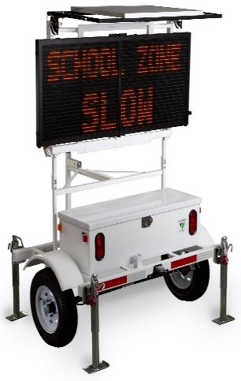
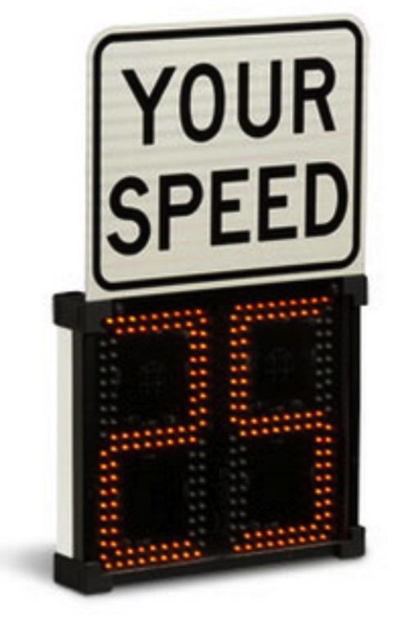
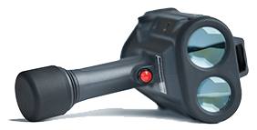
PRODUCTS FOR LAW ENFORCEMENT
ALL OUR PRODUCTS ARE READY!
DRAGONEYE SPEED LIDAR
INSTALERT
SPEEDALERT
SHIELD 12/15
Most portable variable message sign available
Folds to fit in trunk
24” letters
Displays messages specific to speed or dedicated messages
Multiple screens of text, graphics, chevrons or custom images
Portable radar speed display with 12” or 15” digits
Weighs just 12 to 18 lbs.
Rugged, light-weight and easy to use
Perfect fit for traffic monitoring & enforcement
Notes:
These are the traffic devices we make specifically for law enforcement.

Slide 9
WHY ALL TRAFFIC SOLUTIONS?
All our devices are completely cloud-enabled
Remote access to data and devices from any Internet-ready device
Full suite of radar speed displays, variable message signs, speed enforcement tools, count & classify, trailers/mounts
Engineered & manufactured in USA
Industry-leading warranty
Notes:
So to review, we do way more than make the best traffic signs, right in the USA. We provide cloud-based solutions to help you manage your entire traffic safety program.

Slide 10
TRAFFICLOUD
Integrated, Data-Driven Solutions for Better Traffic Safety Outcomes

Slide 11
TOTAL TRANSPORTATION MANAGEMENT
1
2
3
Equipment Management
Alerts
Reporting
4
5
6
Imaging
Mapping
Enforcement
7
8
Parking
Premier Care
Notes:
TraffiCloud is a centralized, web-based ecosystem that lets you access, monitor and manage your traffic devices and data from one central location

Slide 12
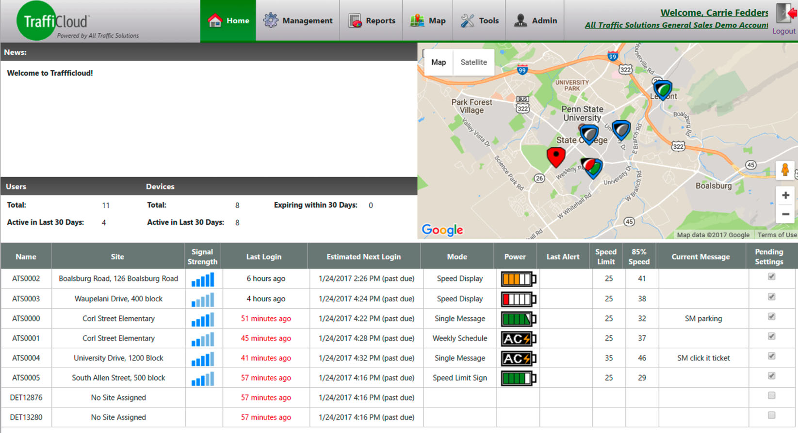
HOME SCREEN
Notes:
This is the TraffiCloud home screen. This is the first thing you seen when you log in – all your important device information and statuses on one screen.
The homescreen shows a Google map of all your traffic devices – so you see the location of all your variable message displays, radar speed signs and count & classify devices.
As you look below the map, you see each of your devices listed, along with location, your last login to the device, what mode each device is currently set to, the battery power of each device, speed limit and 85% percentile for the device if applicable, the current message and the pending settings.

Slide 13
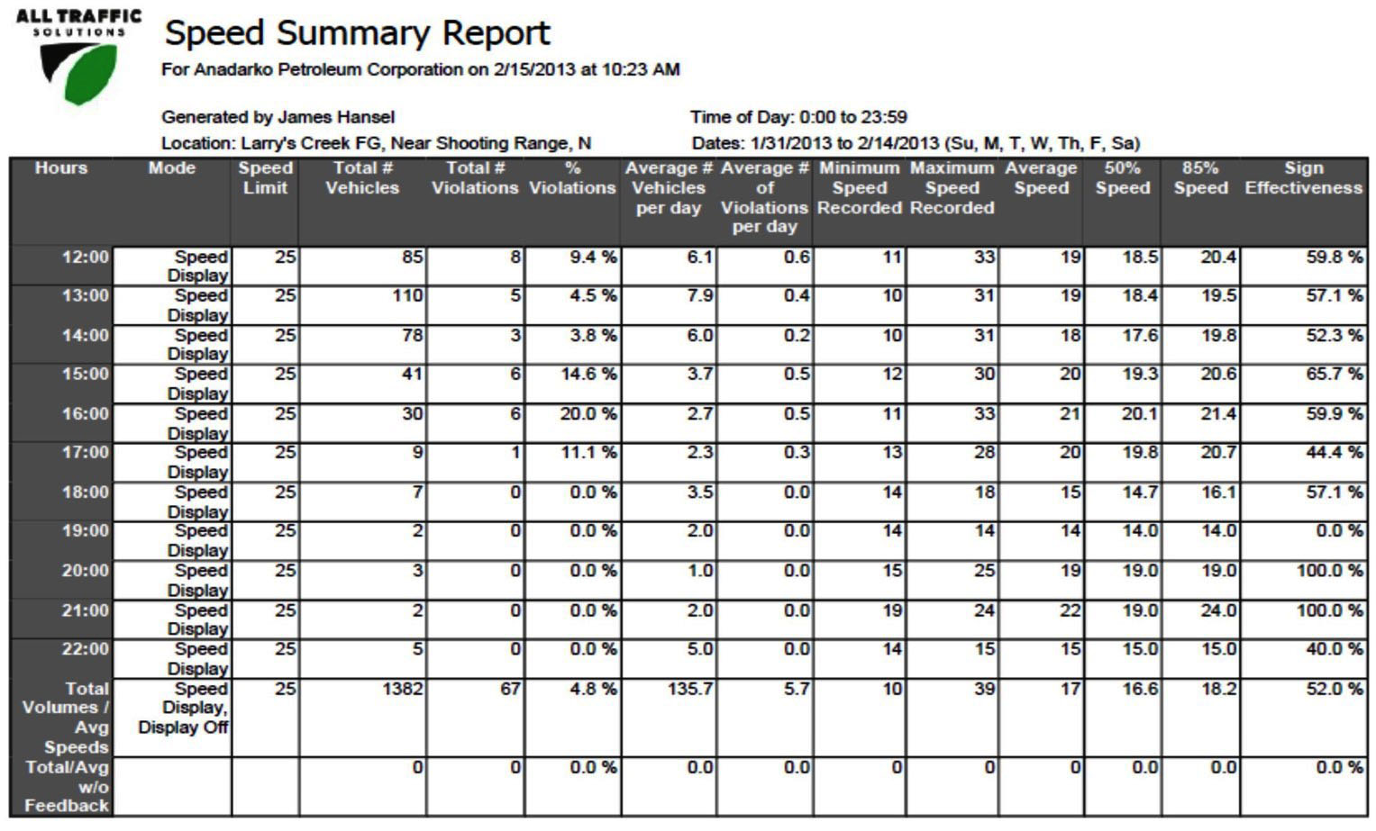
REPORTS
Notes:
Reports – Here are examples of the some of the reports I was telling you about.
This is the speed summary report for one radar speed display. You can see whether the display is in stealth mode (so drivers don’t know the sign is on and recording their speed) or display mode. It also shows, by hour, the speed limit, how many vehicles passed the sign, the number and percentage of speed violations, speed averages, minimum and maximum speeds recorded, and the 50th and 85th percentile speeds. In the last column you can see the sign effectiveness, which is the percentage of vehicles that are traveling at or under the speed limit.

Slide 14
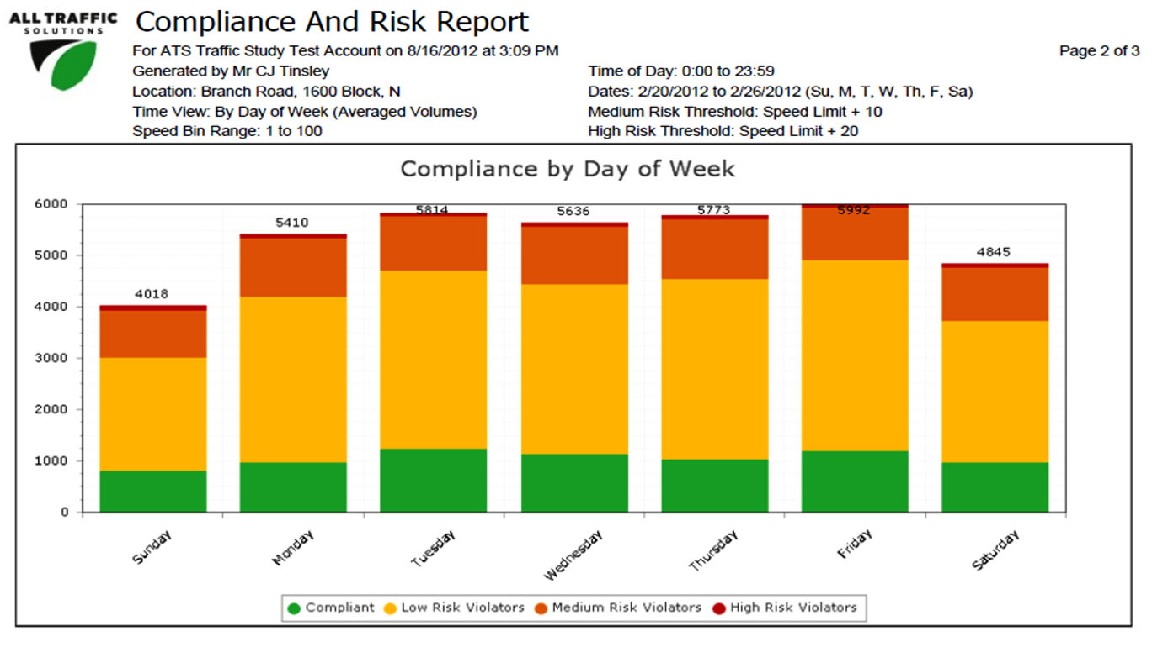
REPORTS
Notes:
This is the Compliance and Risk report, which charts for you, by day of the week, the number of drivers who are violating the speed limit, whether they are low, medium or high risk. The green portion shows the number of compliant drivers. You can also run this report for one particular day of the week, and view violations by hour.

Slide 15
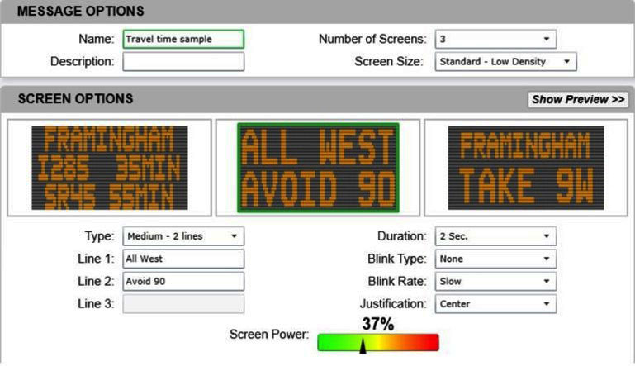
MESSAGING
Notes:
This is a TraffiCloud screen displaying three screen options on an InstAlert variable message display. You can set the duration, blink type and blink rate of each message, and adjust screen power.

Slide 16
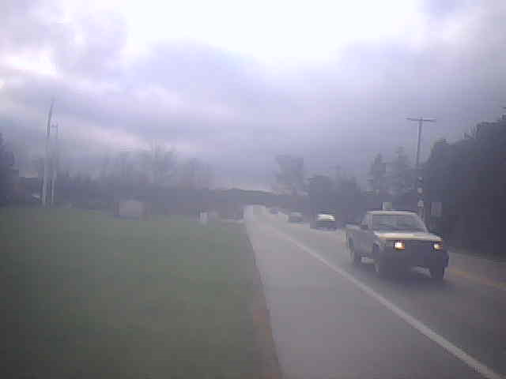
SETTINGS
Custom Automated Email Alerts
---------- Forwarded message ----------
From: <alerts@alltrafficsolutions.com>
Date: Tue, Nov 29, 2016 at 3:34 PM
Subject: Alert!
To: xx@intuitivecontrols.com
A vehicle traveling 53 passed Beside Mt Nittany United Methodist Church at November 29, 2016 3:31:58 PM UTC. The speed limit at this location is 25.
Notes:
You can set TraffiCloud to alert you via email or text of certain types of violations – as they happen. You set the threshold for alerts, and can change the recipients of these alerts at any time you choose.
Here’s an example of an email alert for a vehicle that passed a radar speed display going more than twice the speed limit.

Slide 17
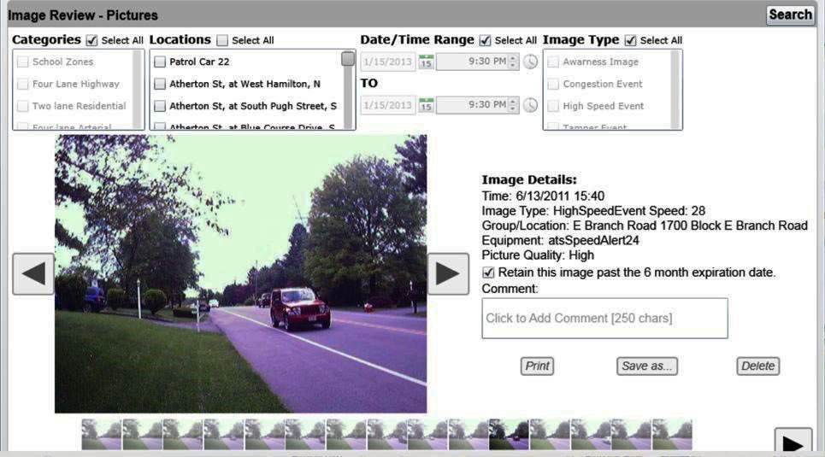
IMAGES
Notes:
TraffiCloud also captures images of violations depending upon your threshold settings.

Slide 18
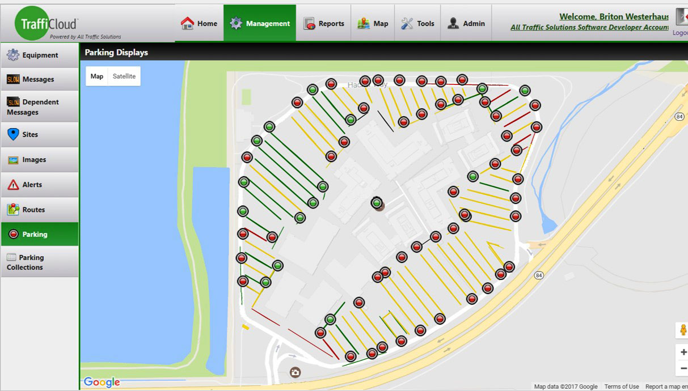
PARKING
Monitor and notify drivers of parking availability using maps that update information every 30-60 seconds
Notes:
Our GPS mapping is great for parking lots and parking facilities as well. Here, you can see by row, which rows of a parking garage have available spaces by the red and green circles. You can use this information to notify drivers at these facilities about where to find available parking spaces. We can also install red and green LED bollards at the end of each row in the parking garage to let drivers know whether the row has spaces available so they can park faster and reduce congestion.

Slide 19
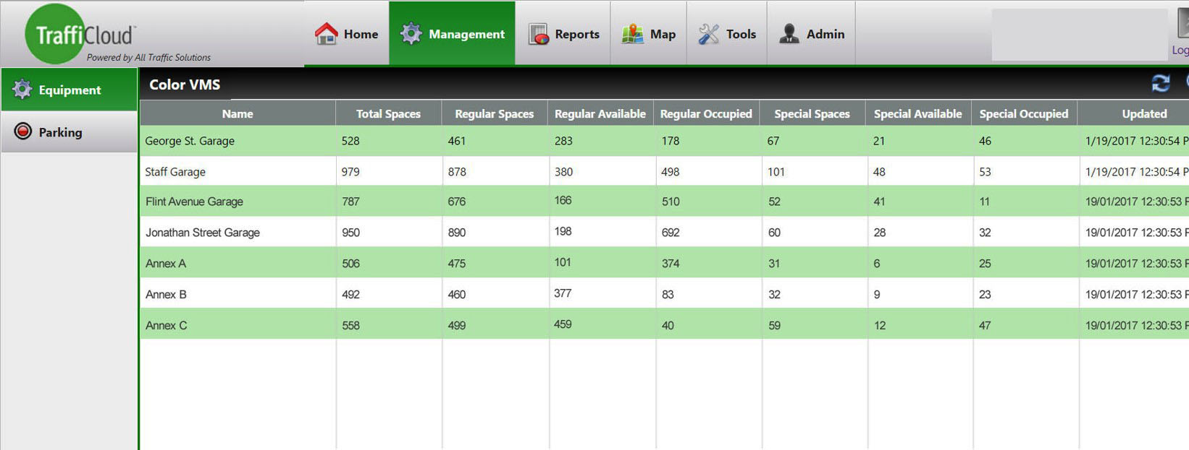
PARKING
Parking Management Dashboard displays availability at all facilities for immediate comparison
Notes:
This report shows the available spaces by parking facility, including regular and special spaces set aside for handicapped parking and for expectant mothers.

Slide 20
MANAGE EVERY COMPONENT
Of your traffic safety program
1
2
3
4
View dashboards & reports of all collected data, or just one traffic device
Make more insightful decisions based on data analytics from all your program components
Remotely access, monitor and manage all connected devices & dynamic messages, regardless of manufacturer, from one central location
Improve workflows, reduce person hours & optimize resources
Notes:
To sum it up, TraffiCloud lets you manage every component of your traffic safety program: fast access to data and reports for insightful decision making, and remote access to your devices to optimize your resource.
So now that you’ve seen a little about all TraffiCloud can do for you, which features do you think would be most beneficial to you?

Slide 21
THANKS!
emailexample@alltrafficsolutions.com
(###) ###-####

