Slide 1
ALL TRAFFIC SOLUTIONS
TRAFFICBRIDGE OVERVIEW

Slide 2
ABOUT ATS
Industry-leading solutions for traffic management, speed enforcement, roadside messaging and parking availability
Patented TraffiCloud™ online management solution provides reports and analytics via remote access from any Internet-connected device
Data and analytics available on-demand 24/7:
Optimized resource utilization
Resolve complaints
Improve safety and traffic calming
Open, flexible, secure & scalable cloud-based solutions
Hardware “agnostic” – ability to instrument literally any type of ITS/Smart Cities IoT technology
All products engineered and built in USA
Notes:
First, just a brief introduction to our company. You might know us for our traffic signs, which are engineered and built in the USA and quality is excellent. But what makes us different is the cloud-based stuff. You don’t have to drive to the sign. Do it all from your desk – save time. The value of our data is that reports are generated for you – no complicated raw data. Resource prioritization report, other reports all with just a few clicks – show the success of your efforts, problem areas, resolve complaints.

Slide 3
TrafficBridge
Versatile Connectivity with TraffiCloud
TrafficBridge™ unifies your existing traffic infrastructure by turning your existing devices into “smart” connected devices that work together in our TraffiCloud™ traffic management ecosystem.

Slide 4
TrafficBridge
LEVERAGE your current infrastructure investment
of the future
SIMPLIFY your operations
BUILD your traffic management system of the future

Slide 5
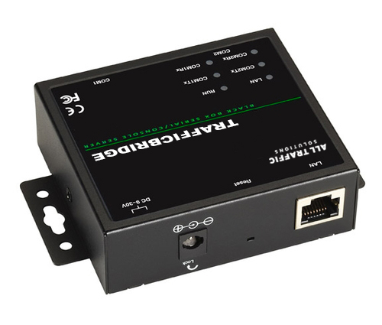
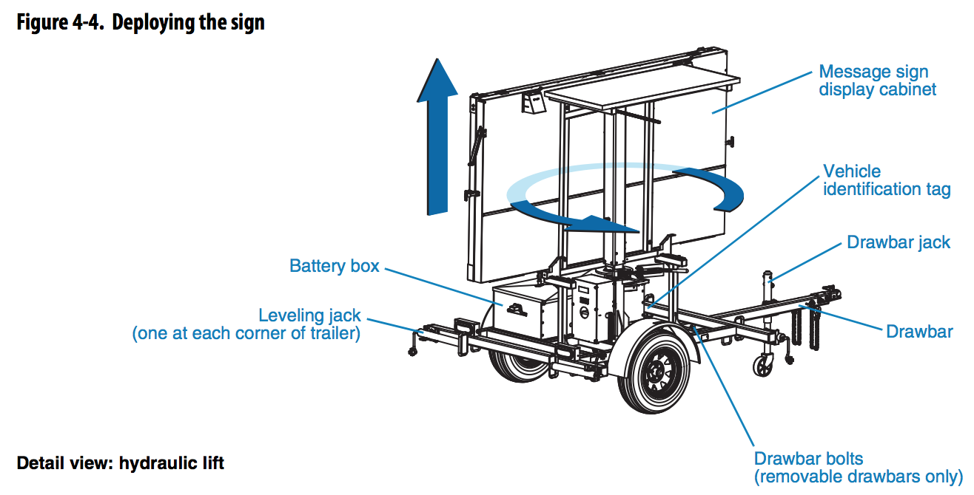
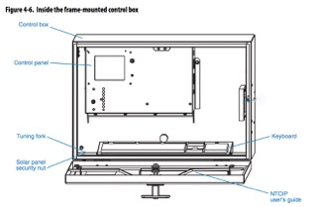
TrafficBridge
How It Works — Physical Instrumentation

Slide 6
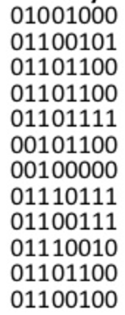
TrafficBridge
How It Works — Data Collection and Translation
Connect
RJ-45
USB-A
USB-B
Serial
RS-232
RS-422
RS-485
DB9 DTE
DB9 DCE
LoRa
915MHz LPWAN
It starts with the native transmission of data to/from the device
The data can be binary, hexidecimal and follow NTCIP, proprietary or any other “standard”
Data translation into the ATS standard protocol is performed by TraffiCloud’s IoT Adapter for staging
Multiple physical connectivity options exist to collect the raw data from the device and transmit it over a 4G LTE cellular network
Sensor Communication and Management
Data Storage/
Cleansing and Mapping
Data Analytics/
Machine Learning
Presentation/ Business Connectivity

Slide 7
TraffiCloud
Integrated, Data-Driven Solutions for Better Traffic Outcomes
Real time availability to maximize yields and usage
All your data in one secure cloud-based parking solution
2
1
Open, flexible, scalable architecture that integrates with your existing solutions
Remote access to equipment reduces time—manage all connected devices and dynamic messages from one central location
3
4
Easy-to-use dashboards and reports of all collected data to allow you to make more insightful decisions based on data analytics from all your program components
5

Slide 8
THANK YOU

Slide 9
TrafficBridge
How It Works – Data Collection and Translation
Connect
RJ-45
USB-A
USB-B
Serial
RS-232
RS-422
RS-485
DB9 DTE
DB9 DCE
LoRa
915MHz LPWAN
Sensor Communication and Management
Data Storage/
Cleansing and Mapping
Data Analytics/
Machine Learning
Presentation/ Business Connectivity

