Slide 1
Traffic and
Transportation Solutions
Alternate cover
All Traffic Solutions

Slide 2

ABOUT ATS
  Industry-leading solutions for traffic management, parking availability, speed enforcement and intelligent messaging
  Patented TraffiCloud™ online management solution offering data and analytics and remote management from any Internet-connected device
  Open, flexible, secure and scalable cloud-based solutions
  Report-ready data and analytics available on-demand 24/7 to help you:
  Manage and communicate parking availability
  Optimize resource utilization
  Improve safety and customer satisfaction
  All products engineered and manufactured in USA
Notes:
Manage and communicate bullet - change ‘and’ to ‘and’
All products bullet - change ‘and’ to ‘and’

Slide 3

THE ALL TRAFFIC ADVANTAGE
Why TraffiCloud is the Better Intelligent Traffic Management Solution
1
2
  Single view into total traffic ecosystem
  Future-proof, open, agile, extensible platform
3
4
  Accommodates existing infrastructure
  Cloud-based SaaS and PaaS economies
Notes:
#2 - Future-proof or Future-ready? Also, I think add a comma after the first word: ‘Future-ready, open, agile, extensible platform’

Slide 4

TraffiCloud
Integrated, Data-driven Solutions for Better Parking Outcomes
Real-time availability to maximize yields and usage
All your data in one secure cloud-based traffic solution
2
1
Open, flexible, scalable architecture that integrates with your existing solutions
Remote management of equipment reduces time—manage all connected devices and dynamic messages from one central location
3
4
Easy-to-use dashboards and reports of all collected data to allow you to make more insightful decisions based on data analytics from all your program components
5
Notes:
Sub-head: uncapitalize ‘Driven’ - Data-driven
#1 - Hyphenat ‘Real time’: Real-time availability

Slide 5








Total Traffic Management
ALERTS
EQUIPMENT
MANAGEMENT
REPORTING
IMAGING
PARKING
MAPPING
PREMIERCARE
ENFORCEMENT
Notes:
TR Notes: Is it PREMIER CARE or PREMIERCARE (no space, like on the back cover of the brochures)?
Also, the edges of the ALERTS, REPORTING and PREMIERCARE icons look like they’re cut off.

Slide 6
The Leading Innovator in Cloud-based Traffic Management
Top of Mind and First on the Road
  Leading the way in sensor-driven transportation
  Leveraging IoT to manage traffic, build intelligent systems and support “smart” cities
  Recognized as the leader in data-driven traffic management solutions
2003
First portable
pole-mountable speed display sign
2005
First changeable
message sign with Bluetooth capabilities
2007
First cross-product communication
2010
First web-based traffic signs
2013
First to patent
cloud-based traffic data collection
2016
$8M in Series A funding, appoints Jim Weaver CEO
2004
First folding changeable
message sign
2006
First remote-
access traffic
safety signs
2008
First ultra-portable
speed display sign
2012
First industry-wide trade-in program
2014
Introduction of TraffiCloud™ web-based ecosystem
Notes:
Heading: No capital necessary for ‘In’ or ‘-Based’ - The Leading Innovator in Cloud-based Traffic Management
Sub-head: No capital necessary for ‘Of’ ‘On’ or ‘The’ - Top of Mind and First on the Road
Paragraph below sub-heading: It all runs together. Break up into separate statements, either running across the top and separated by bullets or as a three-bullet list -
Leading the way in sensor-driven transportation
Leveraging IoT to manage traffic, build intelligent systems and support “smart cities” (Also us full “ “ around smart cities)
Recognized as the leader in data-driven traffic management solutions
2012: Move stray ‘e’ to the line above - ‘industry-wide’

Slide 7

A Single, Better Platform
Work with any sensor or external data without complex
multiple integrations.
From any roadside sensor or external data set…
a holistic view of road, environmental, and facility conditions
TraffiCloud
Notes:
Add period after ‘integrations’
No capitals needed on ‘Holistic View’, ‘Road’, ‘Environmental’ or ‘Facility Conditions’
If you can fit ‘environmental’ on one line that would great. If not, no biggie.

Slide 8


Connected Traffic Solutions for a
Happier, Greener World
For a
ATS Integrated Traffic Management Platform
TrafficBridge
TraffiCloud portal
for legacy traffic
control devices
TraffiCloud
OnRamp
TraffiCloud portal
for third-party wireless
traffic control devices
Traffic and
Transportation
Law
Enforcement
Municipalities
and Parking
Transportation
Logistics
Intelligent
Transportation
Solutions
Notes:
Change ‘3rd-party’ to ‘third-party’

Slide 9

Connecting the World on a Single Integrated
Traffic Platform
Helping organizations of all sizes leverage IoT technology to better manage their
traffic ecosystem
TrafficBridge
TrafficCloud
OnRamp
Connecting Legacy Devices
Connecting Third-Party Devices
Open, extensible, flexible platform
Optimize resources and improve outcomes of traffic initiatives
Compatible with any TraffiCloud-enabled device
Reduce costs
Maximize resources
Enable proactive decision-making
Achieve better traffic safety
and efficiency outcomes
Notes:
TrafficBridge side:
For consistency with the other bullets on this slide, delete ‘s’ from ‘Optimizes’ and ‘improves’ in the second bullet OR add ‘s’ to the verbs in the OnRamp bullets.
OnRamp side:
No capital needed on ‘-Party’ - Connecting Third-party Devices

Slide 10
Ready for an Increasingly Autonomous Future
TraffiCloud gives you the power to integrate across 1,000s of sensor networks.
Simple to connect all physical sensors and dynamic
message signs
Open, flexible platform
Extensible to any sensor
or data set
Existing network of over
3,500 customers
Complex conditional
messaging capabilities
Over 5,000 connection-ready sensors and dynamic message signs in the field
Easy to implement
TraffiCloud
Notes:
Add period after ‘networks’

Slide 11
Connected Traffic Solutions
Leveraging existing infrastructure to create the traffic management ecosystem of the future
Parking
Law
Enforcement
Municipalities
Traffic and Transportation
Transportation Logistics
INTELLIGENT TRANSPORTATION SYSTEMS
/ SMART CITIES
for Instant Congestion Relief
for Safer Communities
for Smarter Communities
for Intelligent Transportation
for Cleaner, More Economical Trucking
Parking Availability
Wayfinding
Traffic Safety
Traffic Management
Traffic Calming
Traffic Safety
Roadside Messaging
Speed Enforcement
Traffic Safety
Parking Availability
School/Work Zone Safety
Roadside Messaging
Traffic Management
Traffic Studies
Safety
Notifications
Gate In/Gate Out Metrics
Wayfinding
Travel Time
Traffic Management
Notes:
Transportation Logistics section, first bullet - Capitalize ‘in’ (for consistency with the rest of this slide)

Slide 12

Our Solutions
Traffic Counting and Classification
Parking
Roadside Messaging
Traffic Calming
Traffic Management
Turnkey, non-invasive sensing, plug and play technology
Cost effective, accurate alternative to Tubes
4-, 6-, or 8- lane bidirectional
Multipurpose radar speed signs
Real-time parking availability, including level counts
Parking data, reporting and analytics
Availability notification and wayfinding
Interactive mapping
Database integration for access control and mass notification
Conditional sensor messaging
Work zone safety
Dynamic messaging, including variable messaging based on driver speed
Flexible pre-programmed messaging
Portable or fixed with multiple power options
Radar speed enforcement
School zone safety
Traffic safety in pedestrian or work zones
TraffiCloud enabled for remote management
Data and reports for speed limit optimization, enforcement priorities, program success and 85th percentile
Event-based and conditional sensor messaging
Wrong Way notification
Traffic safety in pedestrian or work zones
Time to destination and virtual drive times
Notes:
TR’s Notes:
Icons are different shades of blue.
Counting and Classification Section -
First bullet - are turnkey, non-invasive and sensing three separate attributes? If so, insert commas between words.
Second bullet - replace ‘and’ with ‘and’ (I think on ‘plug and play’ above it’s fine.)
Third bullet - hyphenate: 4-, 6-, or 8-lane bi-directional
Fourth bullet - make ‘Multi Purpose’ one word and uncapitalize ‘Radar’ - Multipurpose radar speed signs
Parking section:
Last bullet - replace ‘and’ with ‘and’
Roadside section:
Second bullet - Insert space between ‘Work’ and ‘zone’
Third bullet, line 1 - insert comma after ‘messaging’
Traffic Calming section:
Third bullet - insert space between ‘work’ and ‘zones’
Traffic Management section:
First bullet - Hyphenate ‘Event based’, uncapitalize ‘Conditional’ and correct spelling on ‘messaing’: Event-based and conditional sensor messaging
Second bullet - ‘notificaion’ = notificiation
Third bullet - insert space between ‘work’ and ‘zones’
Fourth bullet - Capitalize names of products/solutions: Time to Destination and Virtual Drive Times
(Existing Notes...)
Need to add products
Time to destination signs
Speed alert / shield
Instalert
Parking availability
Speedlane, stattrack, crosslane
Wrongway
Conditional messaging signs

Slide 13
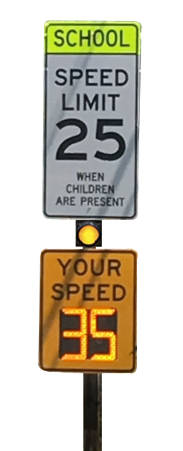

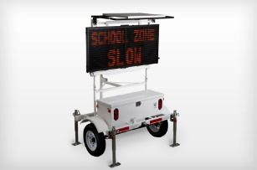

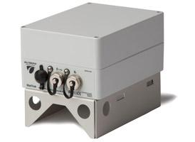
Traffic Calming
Dynamic Speed Displays
School Zone Safety
Radar Speed
Vehicle Counting
Combines radar feedback and
variable messages to provide drivers with speed feedback, speed-dependent messaging or dedicated messages, depending on your needs
at the time
Flexible special event and pre-programmed messaging
Portable or fixed with multiple power options
Radar speed signs for School zone safety
Improve safety of students through speed reduction
Share sign data with local police department via TraffiCloud
Multi-use for school zones, pedestrian walkaways and work zones
Portable radar speed displays improve traffic safety and maximize use of scarce resources
Ultimate in portability
Multiple power sources to choose from
Understand speeds and volumes to identify enforcement priorities
Unobtrusive “stealth” design
Manage remotely using TraffiCloud
Notes:
Dynamic Speed section:
First bullet, line 2 - delete comma after ‘messages’
First bullet, line 7 - delete ‘your’ and the period at the end
School Zone Safety section:
First bullet - insert space between ‘School’ and ‘zone’ and uncapitalize ‘School’ and ‘Safety’
Second bullet, line 1 - delete both ‘the’s
Third bullet, line 1 - delete ‘the’ before ‘data’
Fourth bullet - Change ‘Multi use’ to ‘Multi-use’ or ‘Multipurpose’. Change ‘walkaways’ to ‘walkways’. Insert space between ‘work’ and ‘zones’
Counting:
Second bullet - use full quotation marks around ‘stealth’: Unobtrusive “stealth” design
Third bullet - delete “the”

Slide 14

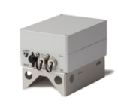
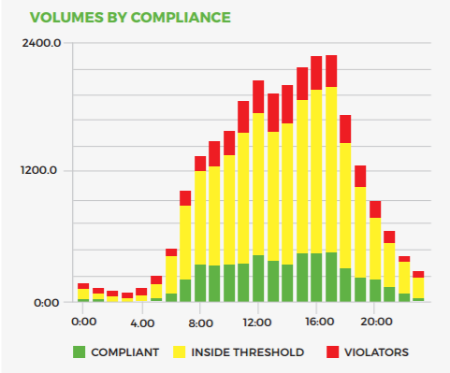
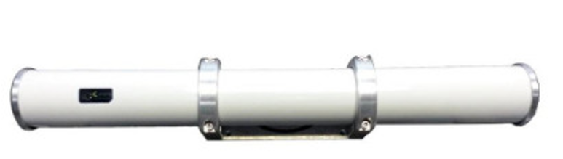
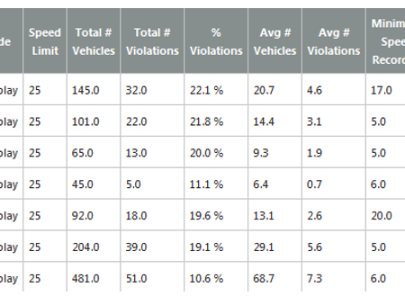
Traffic Counting and Classification
Count
Classify
Multipurpose
Real Time Data and Analysis
Collect bi-directional traffic in up to six lanes at once
Up to two weeks run time on one charge
Simple point-and-go installation with audible signal to confirm aim.
Accurately detect lane, speed and class of individual vehicles
Compute per-lane volume, occupancy, gap, average speed, 85th percentile and headway parameters
Up to eight user- defined lanes
Multipurpose radar speed signs collect volume and speed data
Stealth mode lets you collect baseline data, unaffected by the active speed display.
Multi-use for school zones, pedestrian walkaways and work zones
Eliminate traffic data file management
All of our data collection models combined with the TraffiCloud web-based remote management service
Automatically upload data and generate reports from any Internet-connected computer.
Notes:
TR’s notes:
Count Section:
Third bullet - Hyphenate ‘point and go’: ‘point-and-go installation’. Delete period after ‘aim’
Classify section:
Second bullet - Hyphenate ‘per lane’: ‘per-lane volume, occupancy…’
Third bullet - Hyphenate ‘user defined’ and delete period at the end: ‘user-defined lanes’
Multipurpose section:
First bullet - no capitals needed on ‘Radar Speed’
Second bullet - delete period at the end
Third bullet - Change ‘Multi use’ to ‘Multi-use’ or ‘Multipurpose’. Change ‘walkaways’ to ‘walkways’. Insert space between ‘work’ and ‘zones’
Real Time Data section:
First bullet - delete period
Second bullet, line 1 - insert ‘of’ after ‘All’: (All of our data…)
Second bullet - no capitals needed on ‘Web-based Remote Management Service’
Third bullet - delete period at the end
(Existing Notes…)
Overview of the modules, with slides then for:
Homescreen – mapping, management, k85th percentile
Reports – extended speed summary, risk and compliance
Messaging – Conditional
Settings – alerts
Images
Parking
Wrap up – Benefifts, why buy

Slide 15
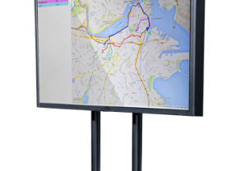
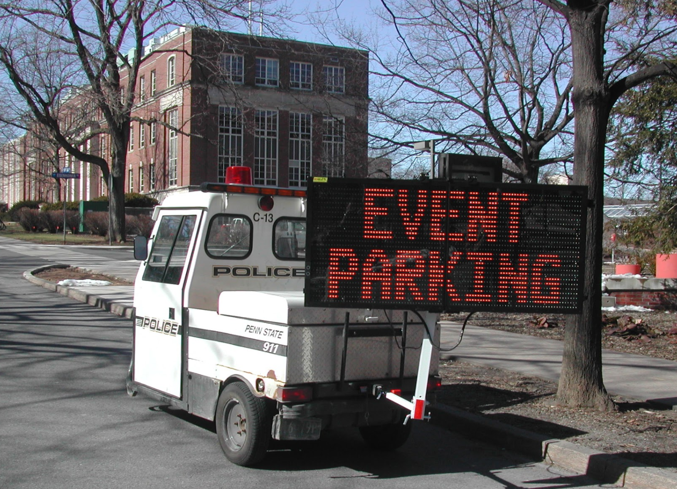
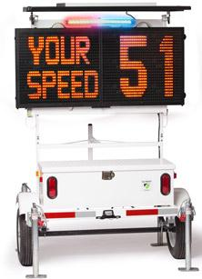

Parking Solutions
Leverage Cloud-based Data for a Smarter City
Travel Time Notification
Parking Availability
Notifications
Speed Calming
Virtual drive times
Interactive mapping
Time to destination notification
Real-time parking availability management, including level counts
Parking data, reporting and analytics
Parking availability notification
Interactive mapping
Integration with employee, vendor, student or other database for access control and mass notification
Conditional sensor messaging
Dynamic messaging from TraffiCloud, including variable messaging based on driver speed
Flexible special event and pre-programmed messaging
Portable or fixed with multiple power options
Radar speed enforcement
Traffic safety in pedestrian or work zones
TraffiCloud enabled for remote management
Data and reports for parking utilization and to optimize speed limits,
claims resolution,
and DoT studies
Notes:
Parking Availability section
Fifth bullet - change ‘and’ to ‘and’
Speed Calming section:
Second bullet - Insert space between ‘work’ and ‘zones’
Fourth bullet - suggested edit: Data and reports for parking utilization and to optimize speed limits, claims resolutions and DoT studies

Slide 16
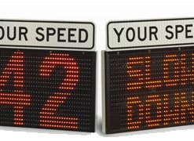

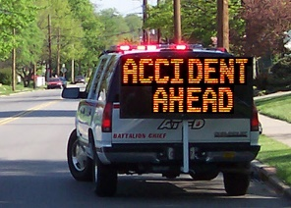

Roadside Messaging
Work zone Safety
Dynamic and Variable Messaging
Conditional Messaging
Event-Based MESSAGING
Program at the sign or remotely
The most portable VMS available
Designed for quick deployment
Fastest, easiest way to tell the public exactly what it needs to know
Combines radar feedback and variable messages to provide drivers with
speed feedback, speed-dependent messaging or dedicated messages depending on
your needs at the time
Flexible special event and pre-programmed messaging
Portable or fixed with multiple power options
Display dynamic messages
based on live inputs
Incorporate sensor or network data into messages
Signs can display such items as road surface or air temperatures, timer values, wait-times, weather or emergency notifications, vehicle weights, available parking spaces and more
Notify public of events quickly and easily
Accidents, detours, special events
Parking availability
Managed at the sign or remotely
Notes:
Workzone Safety section
Heading - Insert space between ‘Work’ and ‘zone’
Second bullet - no capital need on ‘Most’ ‘Portable’ or ‘Available’
Dynamic and Variable section:
First bullet, line 2 - delete comma
First bullet, last line - delete period
Conditional Messaging section:
Third bullet, line 4 - replace hyphen with space: ‘wait times’
Event Based section:
Heading: Change to ‘Event-based Messaging’

Slide 17
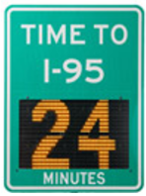
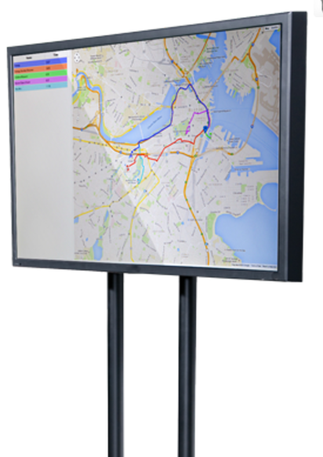


Traffic Management
Wrong Way
Time To Destination
Conditional Sensor Messaging
Virtual Drive Times
Detects and warns drivers and alerts authorities, preventing accidents
Works even when entrance and exit ramps are located immediately next to each other
Helps prevent dangerous situations from escalating
Infrastructure-free time to destination
Display time to destination messages with no sensors
Live travel times for your custom route, updated constantly on a connected, changeable message sign
Display dynamic messages
based on live inputs
Incorporate sensor or network data into messages on variable message signs
Information can include digital inputs, analog inputs or serial strings
Signs can display such items as road surface or air temperatures, timer values, wait times, weather or emergency notifications, vehicle weights, available parking spaces
Help drivers select
the best route
before they hit the road
Ideal for hotel lobbies, parking garages or public elevators
Up to five route options displayed with the travel time for each
Exclusive arrangement with TomTom.
Notes:
.Wrong Way section:
First bullet - Edited text: ‘Detects and warns drivers and alerts authorities, preventing accidents’
Second bullet - delete period at end
Time to Destination section:
First bullet - don’t capitalize ‘Free’
Second bullet - don’t capitalize ‘No Sensors’
Third bullet - insert comma after ‘connected’: (...connected, changeable message…)
Conditional Sensor section:
Second bullet - delete period at end
Third bullet - delete period
Fourth bullet, line 3 - replace hyphen with space: ‘wait times’
Virtual Drive Times section:
First bullet - only capitalized first word
Fourth bullet - Recommended re-write to fit space: ‘Exclusive arrangement with TomTom’

Slide 18
What We Do
Vehicle Count
and Classify
Parking
Putting all the Pieces Together for Better Traffic Management
Hassle-free traffic studies
Detect lane, speed and class of individual vehicles
Non-invasive sensing technology
Remote access to data from any
connected device
Real-time availability management and wayfinding
On-demand reporting and analytics
Integration with external systems and databases for comprehensive parker management
Variable/Conditional
Roadside Messaging
Traffic
Calming
Congestion Management
Integrate sensors to provide real time notifications to drivers
Pre-programmed messages
Variable messaging based on driver speed or other inputs
Radar speed enforcement
Real time data and reports for speed limit optimization, enforcement priorities and program success
Integrate traffic sensors, notification systems and parking management to solve traffic challenges
Wrong Way notification
Time-to-destination and
virtual drive times
Notes:
Subheading: capitalize ‘all’
Variable/Conditional section:
First bullet: hyphenate ‘real time’
Traffic Calming section:
Second bullet - hyphenate ‘Real time’
Congestion Management section:
Third bullet - Edit (because they are solution names): ‘Time to Destination and Virtual Drive Times’

Slide 19
How We Do It
A Simple But Comprehensive Strategy For Better Safety and Control
Instrument
Communicate
Add any existing or future device to your wireless network
Remotely access, monitor and manage all connected devices
and dynamic messages from
one central location
Report
Analyze
View dashboards and reports from one, many
or all traffic devices
More insightful decisions
based on data analytics from
all your program components
Notes:
Subheading: Different font is used on ‘Safety’

Slide 20

What It Means For You
Better Transportation for
Better Cities and Better Lives
  Reduce costs
  Maximize resources
  Make better decisions
  Achieve greater traffic control and safety more efficiently
Notes:
Replace ‘and’ with ‘and’

Slide 21

Why TraffiCloud
Standing Out from the Crowd, by Design
  Open platform allows products from multiple suppliers to be integrated into single network
  Best-of-breed future-proof technology
  Highly cost-efficient cloud-based architecture
Notes:
Second bullet - future-proof or future-ready? Also, are the quotation marks needed? (I’m not certain, based on limited context)

Slide 22


















What Our Clients and Partners Say
Trusted by 5,000+ Public and Private Entities in all 50 States and 20 Countries
“
The metrics the signs pull from the various reports available are becoming a guiding document for our Traffic and Speed Safety Compliance Program. I am thrilled…
-David A. Tomlin, Site Security Lead, DUPONT
  Law Enforcement
  Safety Planning
  Emergency Management
  Public Venues
  Traffic Engineering
  Public Works
  Transportation Departments
  Urban Planning
  University and
  Corporate Campuses
“
“
All Traffic Solutions is like having another officer in the field.
-Police Chief, Sherwood WI, PD
The data is phenomenal. My only regret is not using it sooner.
-Traffic Sergeant, Laguna Beach, PD
Notes:
Third quote: Change ‘us’ to ‘is’

Slide 23






All Traffic Solutions at a Glance
Founded in 1999 in
State College, Pennsylvania
Headquarters in Herndon, Virginia
in the D.C. Technology Corridor
Innovative, patented cloud-based traffic data collection ecosystem
Total Employees: 49, expected
to grow to over 85 by 2018
Four major markets served by over 20 products, expected to grow to over 100 by 2018
Customers in all 50 states
and in 20 countries
Notes:
Second statement on left: hyphenate ‘cloud based’: ‘cloud-based’
Last statement on right: insert comma after ‘products’: ‘over 20 products, expected to grow’

Slide 24






Our Team
JIM WEAVER
TED GRAEF
Chief Executive Officer
Founder and Chief Operating Officer
20+ years directing management, finance, sales, and operations within turnaround
and growth organizations
Founder of ATS; unparalleled industry knowledge and entrepreneurial background
ANDY SOUDERS
INGA BROERMAN
CTO, SVP Engineering
Chief Marketing Officer
Broad experience in architecting and managing advanced information system initiatives for technology leaders
Strategic marketing leader with extensive brand and demand-generation expertise at B2B technology firms and SaaS companies.
JIM HARRIOT
MIKE FARLEY
Chief Financial Officer
VP, Sales
Impressive record of guiding financial growth of emerging technology leaders
Deep experience in executive sales and business development at diverse, fast–growing SaaS startups

Slide 25

Partnership Opportunities
TraffiCloud Ecosystem
  One platform to integrate all systems
  Link smart roadside sensor data, build conditional
  messages, convey messages back to any output
    Dynamic messaging signs
    Traffic applications
    Data feeds to in-vehicle displays
    Holistic I2V communications platform for any level of
    vehicle automation
TrafficBridge / OnRamp
  Connect any sensor or sign to TraffiCloud
  Leverage existing and third-party investments
  to build connected infrastructure
Notes:
‘Trafficloud’- Capitalize the ‘c’

Slide 26

All Traffic Solutions
Connecting the world’s traffic infrastructure to enable
happier, healthier,
greener communities
The Traffic Management Ecosystem of the Future
  Better data
  Real-time adaptive traffic solutions
  Smart congestion reduction
  Intelligent Transportation infrastructure
  Advanced road-user communication
Notes:
Two things:
Shift statements down to align with bullet point icons
Is a capital necessary on ‘Transportation’; is Intelligent Transportation and proper name (fourth bullet)?

Slide 27
Thank you.

